Slide 1
IBM 13 Mar 2025

Slide 2
Agenda
Dot net Framework
CLR
BCL
CLS
Intro to CSharp=> VS 2022
PC
Sequence
Selection
Iteration
OOP

Slide 3
App Logic=> “Hello World”
App Infra Logic
Stdio.h=>
AL
AIL

Slide 4
APP
OS
PL
H/W

Slide 5
Complier
?
s/w
System
Application
General 20%
Specific 80% - ()
Business App

Slide 6
Excel Application
Workbooks
Workbook
WorkSheets
WorkSheet
Sheet
Rows(1,2,3) & Columns(A,B,C)
Intersection of ROW and COLUMN is CELL
Every CELL Has an ADDRESS
They are referred by COLUMN & ROW = A1
CELL can contain
Data
Type
Format
Comment/Note
Formula
Types
Numeric
Alpha(String)
Date & Time
Boolean(True/ False)
….

Slide 7
Formula
Expression
=100+200
Functions
Address
Absolute
Relative
Mixed
A Group of Cell(s)
Is called RANGE

Slide 8
Layered Architecture –Layers are Logical
PL (LOGICAL)
BL
App.Exe(Physical)
DL

Slide 9
Single Tier(App.EXE)
2 Tier
3 Tier(App.EXE)
PL
PL (APP.EXE)
PL (APP.EXE)
DBMS
Dynamic EXE
BL
BL
BL (DLL(s))
DL(FH)
BL
DL(DBMS)
DL(DBMS)

Slide 10
n Tier
Microservice Architecture
PL (APP.EXE)
Distributed Computing (RPC)
SOA
Cloud Computing
BL (N)
DL(DBMS)

Slide 11
Complier
Program
APP Logic
APP Infra Logic
Step 3: System Call Mapping( OS Spec Binding)
Step 1: Check for Syntax & Semantics
H
App Logic(Your Code)
.OBJ
Native Code
Step 2: Linking(Embedded - )
LIB
(AIL) Updates Code
.EXE(Static)
Step 3: System Call Mapping( OS Spec Binding)
Step 1: Check for Syntax & Semantics
H
App Logic(Your Code)
.OBJ
MLC
Step 2: Linking(Truly Linking- Holds Reference to DLL)
Ref
Update Reference
InvApp.EXE
Runtime
Invoice.DLL

Slide 12
DC
Inter-process C (IPC)
DCOM
REMOTING(=>.NET)
RPC
Intranet
DCOM
REMOTING
MSMQ
Internet
WEB Service

Slide 13
Internet & Intranet Framework
.NET F/W
APP
APP
.NET Framework
OS
OS
H/W
H/W

Slide 14

.NET Frameworks and the Common Language Runtime
Data & XML
ASP.NET
Base Classes
Win Forms/
Console
Common Language Runtime
.NET Framework
Windows CE, ME, 2000, .NET
Notes:
“Bringing them closer.”
.NET –
Tools and Frameworks;
Base Infrastructure – Windows, Servers;
Building Block Services;
Internet User Experience – on previous slide

Slide 15
The .NET Framework The .NET Framework and Visual Studio.NET
VB
C++
C#
JScript
…
Common Language Specification
ASP.NET: Web Services
and Web Forms
Windows Forms
Visual Studio.NET
ADO.NET: Data and XML
.NET Framework Base Classes
Common Language Runtime
Notes:
The .NET framework exposes numerous classes to the developer. These classes allow the development of rich client applications and Web-based applications alike. The classes are shown here, divided into four areas.
ASP.NET provides the core Web infrastructure, such as Web Forms for UI-based development and Web Services for programmatic interface development.
User interface development on the Windows platform can be done using Windows Forms.
ADO.NET and XML provide the functionality for data access.
The core base classes provide infrastructure services such as security and transaction management.
You can create code in any of a large number of languages. This code will integrate in a deep, seamless manner via a standard called the Common Language Specification.
Visual Studio.NET provides tools that increases your productivity when creating applications.

Slide 16
Common Language Runtime Multiple Language Support
What about types?
Common type system (CTS)

Slide 17
Common Language Runtime Compilation
Source Code
Assembly
Compiler
C++, C#, VB or any .NET language
csc.exe or vbc.exe
DLL or EXE
Notes:
As a developer you can write code in the language of your choice. Your code is compiled into an Assembly, which is represented as a DLL or EXE.

Slide 18
Source
Code
Development Machine
Compiler
EXE/DLL
(IL)
Class Libraries
(IL)
Class Loader
Security Check
JIT Complier
Target Machine
Uncompiled Method
Managed
Native Code
Execution

Slide 19
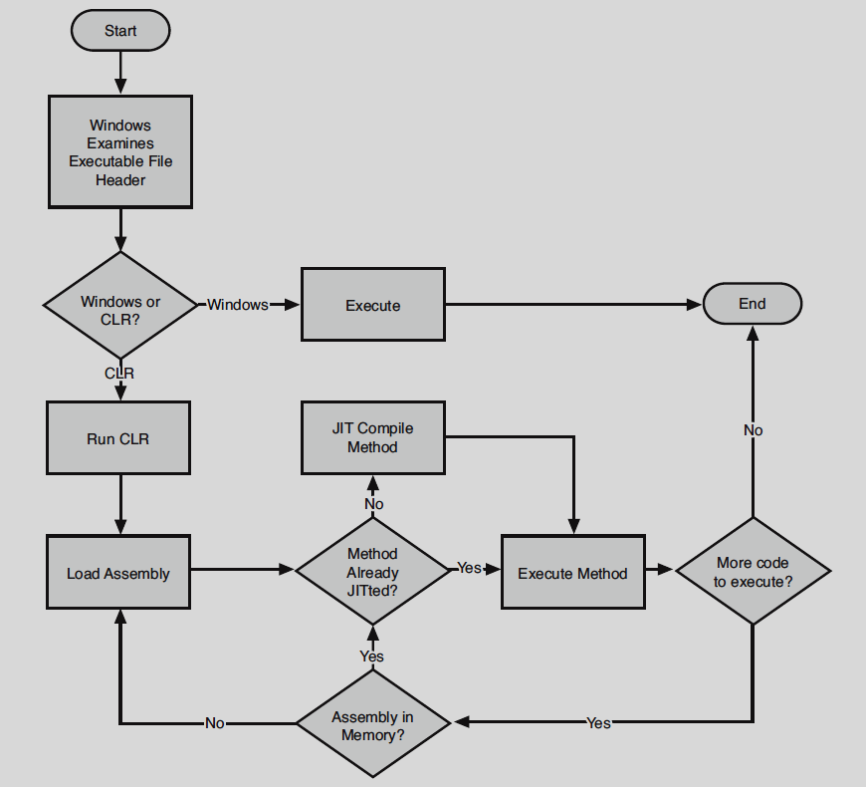

Slide 20
Common Language Runtime Execution Model
Source code
VB
C#
C++
Unmanaged
Component
Compiler
Compiler
Compiler
Managed
code
Assembly
IL Code
Assembly
IL Code
Assembly
IL Code
Common Language Runtime
JIT Compiler
Native Code
Operating System Services

Slide 21
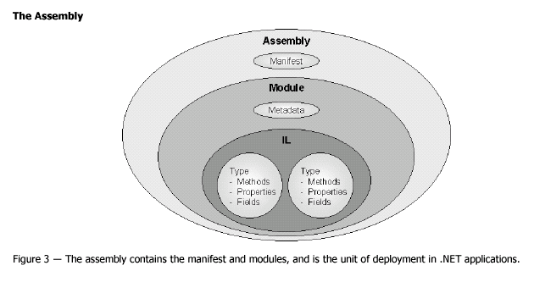
Common Language Runtime Assemblies

Slide 22
Common Language Runtime Manifest & Metadata in an Assembly
Type Descriptions
Classes
Base classes
Implemented interfaces
Data members
Methods
Assembly Description
Name
Version
Culture
Other assemblies
Security Permissions

Slide 23
Common Language Runtime Applications
One or more assemblies
Assemblies resolution
Using metadata
Local Assembly (preferred)
Shared Assembly
Global Assembly Cache
Different applications may use different versions of an assembly
Easier software updates
Easier software removal

Slide 24
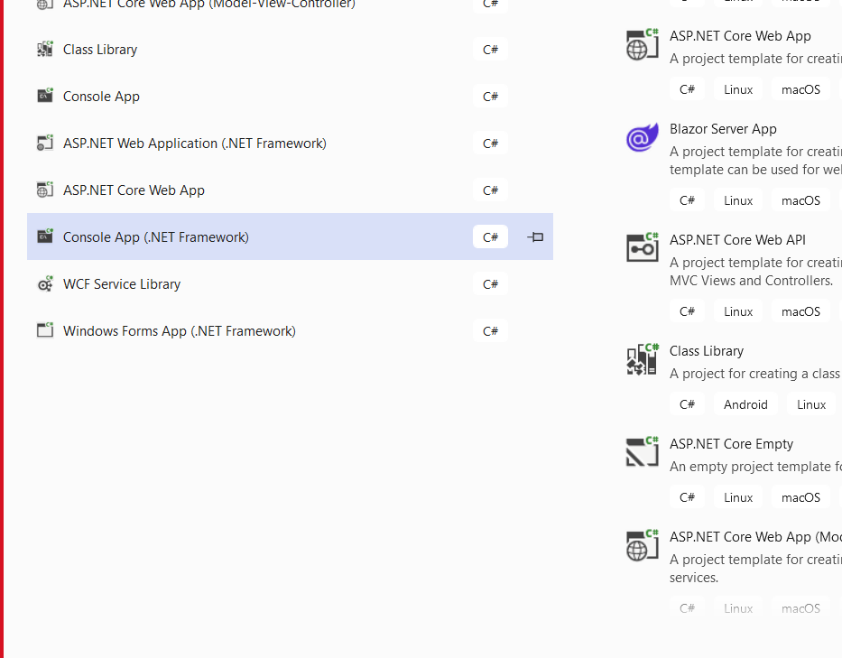

Slide 25
Programming construct
Sequence
Variables
Array
..
Selection
If condition
Switch case
Iteration
For
While

Slide 26
void Main(string[] args)
void Main()
int Main(string[] args)
int Main()

Slide 27
Vs Mode
Design Mode
Execution Mode
Debug Mode

Slide 28
Sequence
Datatype
Value Type
Reference Type
Method
By Val
By Ref
Out
Param
Named & Optional

Slide 29
Debugging
Step into
Step over
Step out
OOP

Slide 30
Datatype
Value Type
Memory is allocated on Stack
When assigned with other Value type it Copies the value
Reference Type
Memory is allocated on HEAP
Assigning reference type variable will copy reference

Slide 31
Value Type
Inbuilt
Numeric
Without Decimal
Signed
Sbyte - 128 – 127= 1 byte
Short – 2 byte
Int – 4
Long -8
Unsigned
Byte-0-255
Ushort
uint
With Decimal
Float - 4
Double -8
Decimal- 16
Alphanumeric
Char=‘A’ 2 bytes
Logical
Boolean/Bool = >4 => TRUE/FALSE
DateTime
8 bytes – 1-Jan-0001 00:00 – 31-Dec-9999 23:59:59
UDT
Enum
Struct

Slide 32
Reference
InBuilt
Array
String
Object-
UDT
Class
Interface
Delegates

Slide 33
Conversion
Transform one value type to another value type
Two Types
Implicit – Auto
When there is no data loss, Manual Execute
Explicit – Manual
When there is data loss
Boxing & unboxing
Casting

Slide 34
Agenda
2002 – ver 1.0=> vs 7.0
OOP
Delegates and Events
[Threading, R & A]
Collections
Ienum & Ienum
2005-Ver 2.0=>vs 8
Generic
Type Inference
Anon Method/Block
Iterators
2008->ver 3.0/3.5 vs 9
LTI
Anonymous Type
Object Init & Coll Init Syntex
Extension Method
LINQ
2010 – ver 4.0 vs 10
Par
PLINQ
TPL
Dynamic Type Inference
Named and Optional Arg

Slide 35
OOP
Encapsulation
Abstraction
Information Hiding
Data Hiding
Implementation Hiding
Polymorphism
Inheritance
Types
Casting
Polymorphism
Constr
Overload
Private, protected, Static
Destr
Implicit
~
Finalizer
Explicit
Idisposable

Slide 36
Methods
Only for Value Type
By Value
By Reference
Out parameter
MethodA => MethodB
Argument passed can be
Input
input & output
Output
Reference type will always be passed as Reference

Slide 37
Object Oriented Programming
Conceptual & Design
Syntax in Csharp

Slide 38
Data + Al = Program
Object
Data
Variable
Array
Struct
Variable
Function
Global Variables
Function to function ;Highly/tightly coupled

Slide 39
Encapsulation
Abstraction
Information Hiding
Private & Public
Data hiding
Implementation Hiding
Polymorphism
Function Overloading(Static)
Inheritance
Access Modifier
Protected
Polymorphism
Function Overriding (Dynamic)

Slide 40
Default
PM
PA
SE
EMP

Slide 41
Default
EMP
FillTimeSheet()
PM
PA
SE

Slide 42
Scenario – Different Implementation in sub class
EMP
FillTimeSheet()
ST
PM
PA
SE
FillTimeSheet()
{
}

Slide 43
Scenario – Different Implementation in All sub class
EMP
FillTimeSheet();
Incomplete
Abstract Method=> Abstract Class
Polymorphism
Runtime Mapping
PM
PA
SE
ST
FillTimeSheet()
{
Cw(“in PM ”)
}
FillTimeSheet()
{
}
Int i=100;
int j=200;
i= j;
Emp objE= new Emp()
PM objPM= new PM()
objE=objPM;
objE1= (PM) objE;
Emp ObjE;
PM objPM= new PM();
objE=objPM;
Emp(EMPID,NAME,SAL)
<=
IBMEmp(Address)

Slide 44
Int i=100
Int j=0;
J=I;
Emp => EmpID, EmpName,FillTimeSheet()
IBMEmp => EmpID, EmpName, Salary
IBMEMP ObjB;
EMP ObjA= ObjB
objA. FillTimeSheet();
IBMEMP=>Emp

Slide 45
Main()
Int Add(int a, int b)
Int Multi(int a, int b)
…..

Slide 46
Encapsulation

Slide 47
Encapsulation – Concept=>Prg-Lng=>Class=>at Runtime Object
Abstraction
Information Hiding
Access Modifiers
Private & Public
Implementation Hiding
Overloading (polymorphic)
Inheritance
Basic
Specialization to Generalization
Overriding (polymorphic)
Scenario 1 (Virtual) ( generalized method sometimes have specialized variation )
Scenario 2 (Abstract) ( generalized methods implementation has many specialized variation therefore only Signature (eg CalculateSalary();) )

Slide 48
Encapsulation brings in Code Redundancy addressed through Inheritance
Generalization
FillTaskSheet()
EMP
PM
PA
SE
Specialization

Slide 49
Scenario -1 Specialization to Generalization to Specialization- Challenge
Fills in Daily
Overriding
FillTaskSheet()
EMP
Fills in weekly
PM
PA
SE
Tester
Over ride ; FillTaskSheet()

Slide 50
Scenario -2 Specialization to Generalization to Specialization- Challenge
Overriding
Fills in Daily
Emp Class is Incomplete- cannot create instance
Called Abstract method & Class
Polymorphism : FillTaskSheet is Existing in many forms in sub classes
Mapping of base class method to derived class is done at Runtime - RUNTIME POLYMORPHISM
FillTaskSheet();
EMP
Fills in weekly
PM
PA
SE
Tester
Override ; FillTaskSheet(){}
Override ; FillTaskSheet()

Slide 51
Emp objE;
PM obj = new PM();
objE=obj;
Int i=100
short j=I
Product{PrdId,PrdName}
Product obj1= new Product();
Product obj2=obj1
Product obj3=new PRDE()

Slide 52
Encapsulation
Inheritance
Dynamic Polymorphism
overriding
Static Polymorphism
OverLoading

Slide 53
Int Add(int I , int J); = > Signature in OOP Context
Employee GetEmployeeById(int EmpId)
Signature from OS Context => int(int,int)
Employee(int)

Slide 54
Encapsulation
Modularity
Inheritance
100% Code Reusability
Polymorphism
100% Extensibility

Slide 55
Abstract Class vs Interface
Abstract
Mostly
20% Extensibility
80% Reusability
Interface
100% Extensibility
Interface (Noun)
At Design
Is Contract
At Runtime
Is Interface(verb) medium of communication

Slide 56
Interface
Is a contract at DESIGN
Is an Interface(Medium) at RUNTIME
CSharp Interface Implementation
Implicit
Explicit

Slide 57
Abstract Class
80%> is Code Reusability
<20% is Extensibility
Interface
100% Extensibility

Slide 58
Constructor
What
Is the first method that gets called implicitly
Why
Initializing the Object
Configuring the variables
How
Name of the class without return type
Note
If Constructor is not manually created then Default Constructor will be Auto-Generated

Slide 59
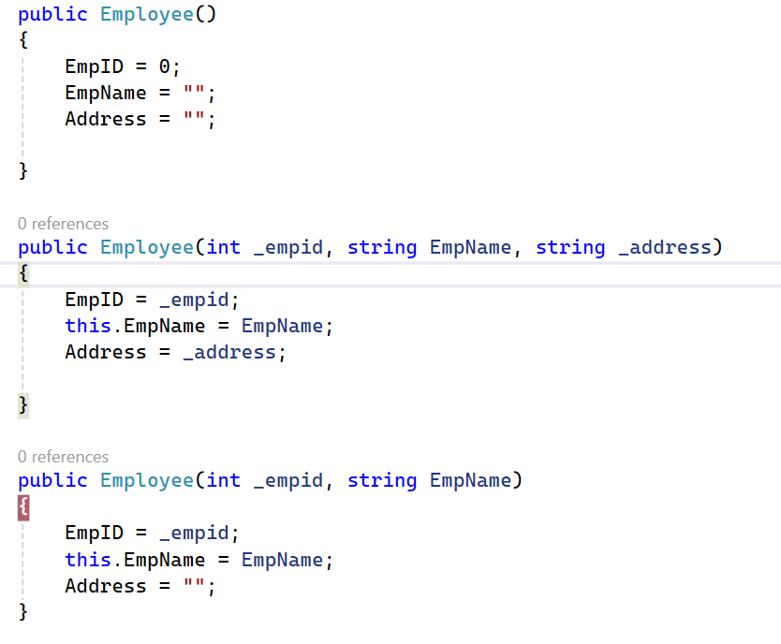
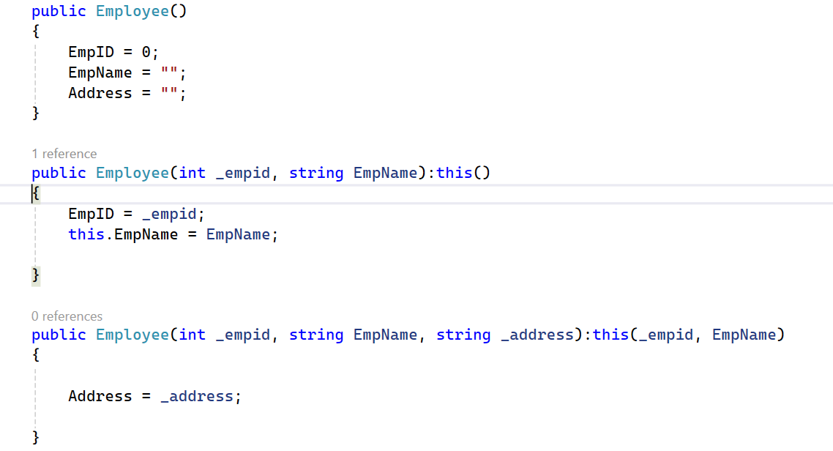

Slide 60
Constructor
Private
Static

Slide 61
Properties & Indexer
What
Syntactical Wrapper for methods used to Set & Get the value from object
Why
(Primary) Encapsulate / conceal data members(Field)
Access control , read only or write only or both
Computed value
Validation
Indexer
Is a property with [ ] (indexer Operator thereby Name Indexer) that can accept argument(s)
Name must be ‘this’ meaning the name is the name of the object itself.

Slide 62
Agenda
GC
Dest
Exce Handling
_____
Method oper
Generic
Delegate
Collection

Slide 63
.NET Version & Features List
1.0 => 2002 = > vs 7.0
Delegates & Events
Collections
Ienumerable & Ienumerator
2.0 => 2005 => vs8 vs 2005
Generic
Iterators
Anonymous Method / Block
3.0 > 2008 = > vs 9
Lambda Expression
Local Type Inference / Implicitly Typed
Object initializer & Collection Initializer Syntax
Anonymous Type
Extension Method
3.5 - > 2008 = > vs 9
LINQ
Query Expression
4.0 - > 2010 => vs 10
ADO.NET Entity Framework

Slide 64
Ctor & Dtor
Delegates
Collections
Ienumerable & Ienumerator
Generic
Iterators
Anonymous Method / Block
Lambda Expression
Local Type Inference / Implicitly Typed
Object initializer & Collection Initializer Syntax
Anonymous Type

Slide 65
Delegate
Preface
What is Pointer
Data
Type?
Memory?
Function
What
Is as Class
Holds 0..* of Method Reference
Must Inherit from System.MulticastDelegate=>System.Delegate
Why
Decouple Method Calls

Slide 66
Void main()
Void()=>signature
Int demo(string[] st, employee e)
Int(string[],employee)
Employee[] GetEmployeeDetails(string Filter, int SortColumn)
Emplyee[] (string,int)

Slide 67
Collections
What
In .NET framework, it Is a class
Holds 0..* no of Object Reference
Object Reference can be same type or Mixed
Why
Object Model
Grouping
Syntactically
Must be a class that implements Icollection
In 1.0/1.1
System.Collection
In 2.0
System.Collections.Generic

Slide 68
Collection
Collection holds 0..* no of object Reference
Retrieve Data / Accessing Data
Sequential
Ienumerable
Random
Index Based
Ilist
Key Based
Idictionary
Specialized Collection
Stack
Queue
Hashtable

Slide 69
Generic
Datatype Introduced Code Redundancy is addressed by Generic
Generic Operator Level
Method Level
Property & Indexer
Class Level
Delegate
Interface

Slide 70
3.0 > 2008 = > vs 9
Local Type Inference / Implicitly Typed
Object initializer & Collection Initializer Syntax
Anonymous Type
Extension Method

Slide 71
Type Inference
Based on the Value Datatype is Inferred
Var i=100;
Level of Inference
Static (Compilation Time)
Var i=100
Dynamic (at Runtime) (From 4.0 )

Slide 72
Anonymous Type
Class will be generated by CSharp Complier
All the Properties are READ Only

Slide 73
Extension Method
Is a syntactical sugar
Must be public & static
Must be defined in a static class
Must have ‘this’ keyword before first arguments type
To which the Method is Syntactically Attached / Behaves Extended

Slide 74
LINQ
One Query API for Various Data Sources
Data Sources
Objects
Array
Collection
List
Dica
XML Doc
Database
Oracle
PL/SQl
SQL Server
T-SQL
Operation Performed on Datasource
DML insert,update,Delete ; 30%
DQL –Select 70% (Filter (90%), Joins(70%), Sorting(60%), Grouping(50%))

Slide 75
LINQ
3.5
To Objects
IEnumerable
To XML
To ADO.NET
To SQL
4.0
Replaced LINQ to SQL with
LINQ to Entities(ADO.NET EF)

Slide 76
Agenda
Intro to SQL
DQL
Select
Filtering, Grouping, Sorting, Joining
Sub Query
DML
Insert, Update & Delete
DDL
Creating Table, 0View, Proc, Func, Triggers
Variable, PC, Cursor
Transaction

Slide 77
List<Subject> lstSubjects=…;
Ienumerable<Subject> qry= lstSubjects;
Employee { EmpID:Int,EmpName:string,Salary:double}
ibmEmployee:Employee {Address:string}
IbmEmployee Obj1=new….
Employee Obj2 =obj1;

Slide 78
Agenda
LINQ
Standard Operators
ADO.NET EF
Intro ORM
Developer Work flow
Model First, Db First, Code first
DbContext
DbSet
Change Tracking
CRUD operation
Invoke Stored Proc
Intro to ASP.NET
Intro
Page Controller Pattern
Page life cycle Events
Server Controls

Slide 79
OrderByDescending()
OrderBy() – Asc
ThenBy()
ThenByDescending()

Slide 80
ADO.NET
ActiveX Data Objects . Net

Slide 81
File Handling (ST)
Flat-File
APP
File Handling

Slide 82
DBMS=> RDBMS – Physical & Logical
Data Model
Hierarchical (One to One , One to Many)
Network (patch for Many to Many)
SQL
One Language for both Data & Administration (Metadata)
DBMS to RDBMS
Relational Model (Set theory) (EF Codd Rules 12 )
Representing Data in the form of Rows & Column that is Table(Relation)
Relationship
One to One , One to Many & Many to Many
Native DB API
DBMS=>RDBMS
APP
Files
Logical
Physical

Slide 83
RDBMS
First Name | Last Name | City | Phone No | DOB | Department | Salary | Project Name
Ganesh | Mahesh | Bangalore | 123444 | 12/1/12 | SLS | 23433 | SHELL
Mahesh | Suresh | Bangalore | 432144 | 10/1/10 | MKT | 32432 | SHELL
Dinesh | Krishna | Delhi | 545344 | 1/1/1 | FIN | 32423 | DHL
Suresh | Ramesh | Pune | 435345 | 2/2/2 | FIN | 34234 | DHL
Tables
Normalization
1 to 3

Slide 84
First Name | Last Name | City | Phone No | DOB | Department | Salary | Project Name
Ganesh | Mahesh | Bangalore | 123444 | 12/1/12 | SLS | 23433 | SHELL
Mahesh | Suresh | Bangalore | 432144 | 10/1/10 | MKT | 32432 | SHELL
Dinesh | Krishna | Delhi | 545344 | 1/1/1 | FIN | 32423 | DHL
Suresh | Ramesh | Pune | 435345 | 2/2/2 | FIN | 34234 | DHL

Slide 85
EMPID(PK) | First Name | Last Name | Phone No | DOB | DeptID
100 | Ganesh | Mahesh | 123444 | 12/1/12 | 2001
101 | Mahesh | Suresh | 432144 | 10/1/10 | 2001
102 | Dinesh | Krishna | 545344 | 1/1/1 | 2002
103 | Suresh | Ramesh | 435345 | 2/2/2 | 2003
EMPID | Salary
100 | 23433
101 | 32432
102 | 32423
103 | 34234
EMPID(1:1)
ProjectEmployee(*:*)
EmployeeProject
Project ID | EMP ID
4001 | 100
4002 | 100
4001 | 101
4002 | 102
4001 | 101
Dept ID | Department
2001 | SLS
2002 | MKT
2003 | FIN
Project ID | Project Name
4001 | SHELL
4002 | DHL

Slide 86
ODBC (Open Database Connectivity )
ODBC Driver
DBase
ODBC (Manager)
Files
ODBC API
ODBC Driver
Foxpro
APP
Files
ODBC Driver
Oracle
Files

Slide 87
DAO=> VB 3.0(Data Access Object)
MS Access
MS Jet DB Engine
Files
DAO
Fox-Pro
APP
Files
D-Base
Files

Slide 88
RDO=> VB 4.0(Remote Data Object)
ODBC Driver
SQL
ODBC (Manager)
Files
RDO
ODBC Driver
Sybase
APP
Files
ODBC Driver
Oracle
Files

Slide 89
ADO=> VB 6.0(ActiveX Data Object)
OLEDB Provider
RDBMS
OLEDB (Manager)
Files
ADO
OLEDB Provider
DBMS
APP
Files
OLEDB Provider
Non-Db
Files

Slide 90
ADO Architecture
Your Application
ADO
OLE DB
ODBC Provider
Simple Provider
Native Provider
ODBC
OLE DB Provider
OLE DB Provider
ODBC Driver
Text File
Mainframe
Database
Database

Slide 91
Summary
File Handling
Native Database API
ODBC (Open Database Connectivity)
Interoperability to a wide range of database management systems (DBMS)
Widely accepted API
Uses SQL as data access language
DAO (Data Access Objects)
Programming interface for JET
RDO (Remote Data Objects)
Tighter coupling to ODBC
Geared more to client/server databases (vs. DAO)

Slide 92
ADO.NET Overview
OLE DB
Broad access to data, relational and other
Built on COM
Not restricted to SQL for retrieving data
Can use ODBC drivers
Low-level (C++) interface
ADO (ActiveX Data Objects)
Simple component-based, object-oriented interface
Provides a programming model to OLE DB accessible outside of C++

Slide 93
ADO.NET Overview Managed Providers
Your Application
ADO.NET Managed Provider
SQL Managed Provider
ADO Managed Provider
OLE DB Provider
SQL Server Database
Database

Slide 94
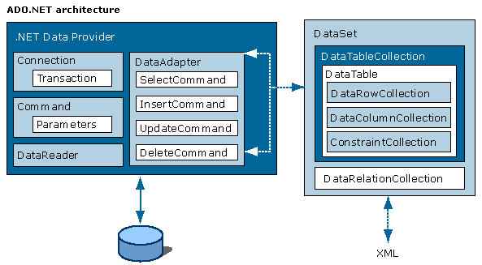
ADO.NET Architecture

Slide 95
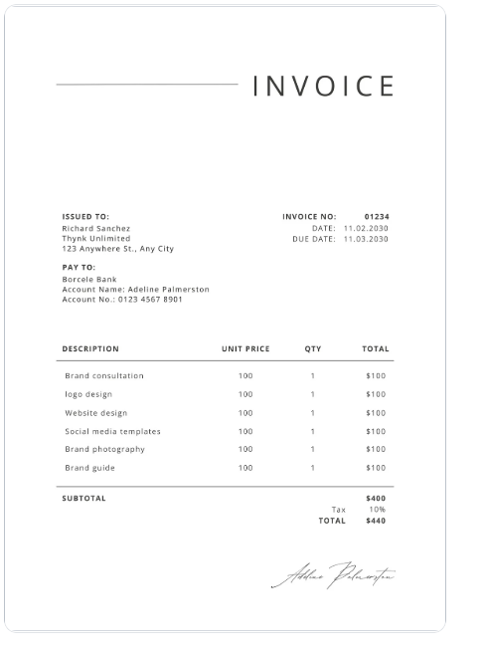

Slide 96
ADO.NET Classes System.Data Namespace
Contains the core classes of the ADO.NET architecture
Disconnected DataSet is central
Supports all types of applications
Internet based
ASP.NET
XML
Windows forms based

Slide 97
ADO.NET Classes DataSet
DataSet
DataTable
DataColumn
DataRow
DataRelation
Notes:
This is a simplified view of the containment relationships in a DataSet. There are actually many other collections and types of objects involved.

Slide 98
Need for Dataset
Database Tenets
Data in database is always consistent (Else it is a bad design)
You never require all the data all the time data is retrieved based on scenario for Eg. Sales Data for the Day/Month ( viewed from different perspective , Customer Wise, Product Wise, Category Wise , day Wise , Daily Summary for the given Month…. )
Concurrency is required only on certain column and it is required in the scope of 0..2%
Data once stored it cannot be modified.
Dataset
Miniature version of the Database to represent data for a particular scenario
Occasionally connected Application
What if analysis

Slide 99
Datatable GetEmployees()
List<Employee> GetEmployees()
Entity Framework
Concept
ORM
Object Model to Relational Model Mapper
Object Relational Mapper
API
Data Access Layer
Entity Layer (Generate using VS / Create from manually )

Slide 100
ADO.NET Entity Framework
Entity Framework is Extension to ADO.NET
ORM
Object Model to Relational Model Mapper
Object Relational Mapper
Datatable GetEmployeeDetails()
List<Employee> GetEmployeeDetails()
EF
Entity Layer (Generated)
DAL - Programming
EF is ORM Tools & API

Slide 101
Networking
Intranet
ASCII(UTF -8) 0-255=256 (Charset)
Internet
Unicode=> UTF-16=2 Bytes
http://ibm.com/india/index.html
HTML=>HTTP
URL

Slide 102
Application Centric Data
Data Centric Application
Browser
HTML
REST
HTTP
VERB
URL
HTML

Slide 103
History of Web

Slide 104
Jquery/ Jquery UI / KO JS, NG
JAVASCRIPT
DOM (CSS)- AJAX
HTML

Slide 105
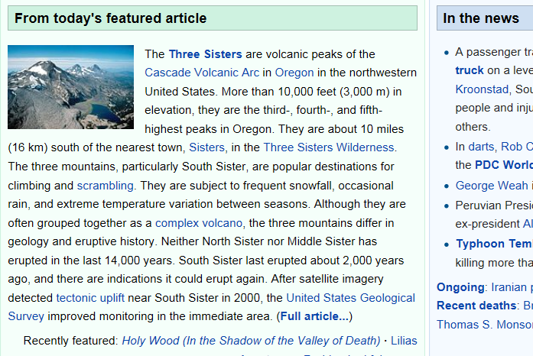
HTTP Request
Browser
Web Server(IIS)
Internet
Interpreter
HTTP Response (HTTP Status)
Static Page
First Architecture;
Sharing the Info
Rendering

Slide 106
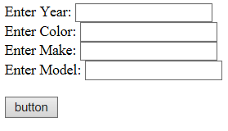
HTTP Request
Browser
Web Server(IIS)
Internet
Int
HTTP Response
BL
DL
Dynamic Page
PL(UI through HTML)
Second Architecture;
Application Programming Infra static Content
1. Upgrade HTML to support
Accept Data from user (Input tags ->
GUI Components)
2. To Support BL & DL On Server
3.Upgrade HTTP Request to Carry Data
HTTP Verb-> Get Post Put Delete
4. On the Browser Must Render the Tag
Rendering

Slide 107

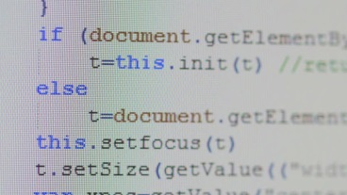
PL(UI through HTML)
HTTP Request
Browser
Web Server(IIS)
Internet
Int
HTTP Response
BL
DL
Dynamic Page
Create Object Model
JAVASCRIPT
Modify DOM
Third Architecture;
Application Programming Infra
with Dynamic Content(DHTML)
D=DOM+CSS+Javascript
Rendering / Re-render
1. Interpret and generate DOM
2. Render based on DOM
3.Any Changes to the DOM is actively listened by the browser and rendered
Rendering

Slide 108
PL(UI through HTML)
HTTP Async Request
Browser
Web Server(IIS)
Internet
Int
HTTP Response
BL
DL
Dynamic Page
Create Object Model
JAVASCRIPT
Modify DOM
Rendering / Re-render
Fourth Architecture;
AJAX
Rendering

Slide 109
WEB API
REST Ful Service
URL=> NOUN
HTTP =>
Status Code
Hyper Link(Hyper Text)
REST Ful API

Slide 110
JavaScript Overview

Slide 111
Type Inference
Static
Dynamic

Slide 112
Lesson
Object oriented programming in JavaScript
Events
JSON
AJAX

Slide 113
JavaScript types
Although JavaScript has no concept of classes, it still uses two kinds of types:
Primitive
Primitive types are stored as simple data types.
Reference
Reference types are stored as objects, which are really just references to locations in memory.

Slide 114
Primitive types
There are five primitive types in JavaScript
Boolean
true or false
Number
Any integer or floating-point numeric value
String
A character or sequence of characters delimited by either single or double quotes (JavaScript has no separate character type)
Null
A primitive type that has only one value, null
Undefined
A primitive type that has only one value, undefined (undefined is the value assigned to a variable that is not initialized)

Slide 115
Essential Recap
identity operator === and !==
does not do type coercion
If the two operands are of the same type and have the same value, then === produces true and !== produces false.
equality Operator == and !=.
does type coercion( meaning that the interpreter implicitly tries to convert the values before comparing)
Does same as above if the operands are of the same type, but if they are of different types, they attempt to coerce the values.
Notes:
operator (Equality)

Slide 116
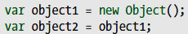
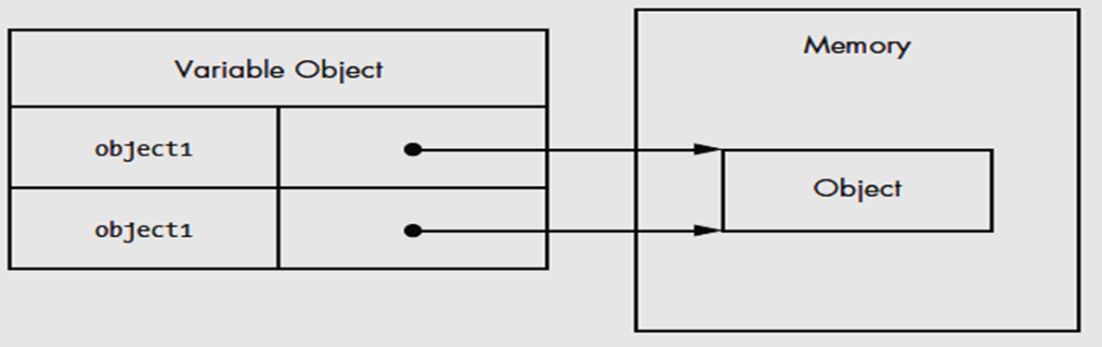
Reference Types
Reference types represent objects in JavaScript and are the closest things to classes that you will find in the language.

Slide 117
The built-in Reference types
Object
A generic object
Array
An ordered list of numerically indexed values
Date
A date and time
Error
A runtime error (there are also several more specific error subtypes)
Function
A function
RegExp
A regular expression

Slide 118
Primitive Wrapper Types
There are three primitive wrapper types
String
Number
Boolean
These special reference types exist to make working with primitive values as easy as working with objects.
(It would be very confusing if you had to use a different syntax or switch to a procedural style just to get a substring of text.)
The primitive wrapper types are reference types that are automatically created behind the scenes whenever strings, numbers, or Booleans are read.

Slide 119
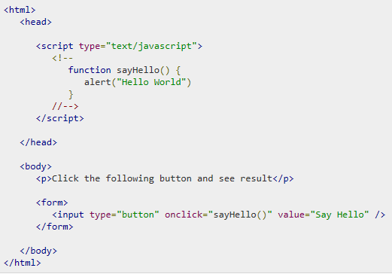
Events
An event is a signal from the browser that something has happened.
JavaScript-applications perform actions as a response to events.
JavaScript's interaction with HTML is handled through events that occur when the user or the browser manipulates a page.

Slide 120
AJAX
AJAX stands for Asynchronous JavaScript and XML.
it is the amendment of the XMLHttpRequest to the DOM
It can send as well as receive information in a variety of formats, including JSON, XML, HTML, and even text files.

Slide 121
JSON
JSON (JavaScript Object Notation) is a lightweight data-interchange format.
It is easy for humans to read and write.
It is easy for machines to parse and generate.
It is based on a subset of the JavaScript Programming Language, Standard ECMA-262 3rd Edition - December 1999.
JSON is built on two structures:
A collection of name/value pairs. In various languages, this is realized as an object, record, struct, dictionary, hash table, keyed list, or associative array.
An ordered list of values. In most languages, this is realized as an array, vector, list, or sequence.
http://www.json.org/

Slide 122
HTML 5

Slide 123
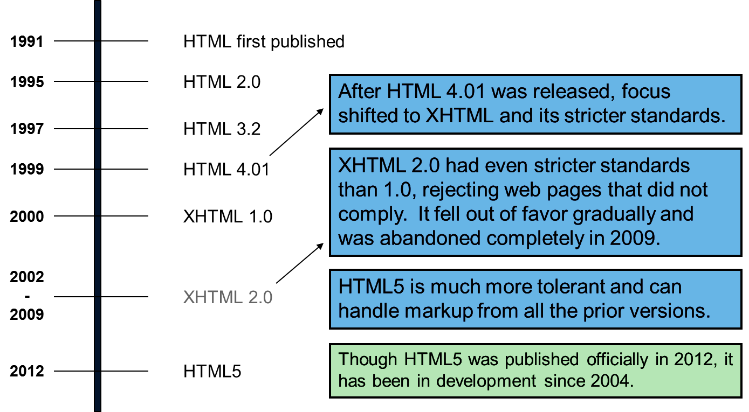
History of HTML

Slide 124
What Is XHTML?
stands for EXtensible HyperText Markup Language
is almost identical to HTML
is stricter than HTML
is HTML defined as an XML restricted
is supported by all major browsers

Slide 125
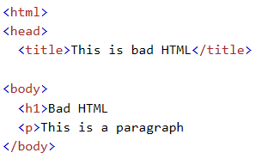
Why XHTML?
Many pages on the internet contain "bad" HTML.
This HTML code works fine in most browsers (even if it does not follow the HTML rules):
Today's market consists of different browser technologies. Some browsers run on computers, and some browsers run on mobile phones or other small devices. Smaller devices often lack the resources or power to interpret "bad" markup.
XML is a markup language where documents must be marked up correctly (be "well-formed").

Slide 126
The Most Important Differences from HTML
Document Structure
XHTML DOCTYPE is mandatory
The xmlns attribute in <html> is mandatory
<html>, <head>, <title>, and <body> are mandatory
XHTML Elements
XHTML elements must be properly nested
XHTML elements must always be closed
XHTML elements must be in lowercase
XHTML documents must have one root element
XHTML Attributes
Attribute names must be in lower case
Attribute values must be quoted
Attribute minimization is forbidden

Slide 127
Who Is Developing HTML5?
Web Hypertext Application Technology Working Group (WHATWG):
Founded in 2004 by individuals working for browser vendors Apple, Mozilla, Google, and Opera, WHATWG develops HTML and APIs for web application development and provides open collaboration of browser vendors and other interested parties.
World Wide Web Consortium (W3C):
The W3C contains the HTML working group that is currently charged with delivering the HTML5 specification.
Internet Engineering Task Force (IETF):
This task force contains the groups responsible for Internet protocols such as HTTP. HTML5 defines a new WebSocket API that relies on a new WebSocket protocol, which is under development in an IETF working group.

Slide 128
What is HTML5?
HTML5 is the newest version of HTML, only recently gaining partial support by the makers of web browsers.
It incorporates all features from earlier versions of HTML, including the stricter XHTML.
It adds a diverse set of new tools for the web developer to use.
It is still a work in progress. No browsers have full HTML5 support. It will be many years – perhaps not until 2018 or later - before being fully defined and supported.

Slide 129
Goals of HTML5
Support all existing web pages. With HTML5, there is no requirement to go back and revise older websites.
Reduce the need for external plugins and scripts to show website content.
Improve the semantic definition (i.e. meaning and purpose) of page elements.
Make the rendering of web content universal and independent of the device being used.
Handle web documents errors in a better and more consistent fashion.

Slide 130
New Elements in HTML5
<article>
<aside>
<audio>
<canvas>
<datalist>
<figure>
<figcaption>
<footer>
<header>
<hgroup>
<mark>
<nav>
<progress>
<section>
<source>
<svg>
<time>
<video>
These are just some of the new elements introduced in HTML5. We will be exploring each of these during this course.

Slide 131
Other New Features in HTML5
Built-in audio and video support (without plugins)
Enhanced form controls and attributes
The Canvas (a way to draw directly on a web page)
Drag and Drop functionality
Support for CSS3 (the newer and more powerful version of CSS)
More advanced features for web developers, such as data storage and offline applications.

Slide 132
First Look at HTML5
Remember the DOCTYPE declaration from XHTML?
<!DOCTYPE html PUBLIC "-//W3C//DTD XHTML 1.0 Transitional//EN"
"http://www.w3.org/TR/xhtml1/DTD/xhtml1-transitional.dtd">
In HTML5, there is just one possible DOCTYPE declaration and it is simpler:
<!DOCTYPE html>
Just 15 characters!
The DOCTYPE tells the browser which type and version of document to expect. This should be the last time the DOCTYPE is ever changed. From now on, all future versions of HTML will use this same simplified declaration.

Slide 133
The <html> Element
This is what the <html> element looked like in XHTML:
<html xmlns="http://www.w3.org/1999/xhtml" xml:lang="en" lang="en">
Again, HTML5 simplifies this line:
<html lang="en">
The lang attribute in the <html> element declares which language the page content is in. Though not strictly required, it should always be specified, as it can assist search engines and screen readers.
Each of the world’s major languages has a two-character code, e.g. Spanish = "es", French = "fr", German = "de", Chinese = "zh", Arabic = "ar".

Slide 134
The <head> Section
Here is a typical XHTML <head> section:
<head>
<meta http-equiv="Content-type" content="text/html; charset=UTF-8" />
<title>My First XHTML Page</title>
<link rel="stylesheet" type="text/css" href="style.css" />
</head>
And the HTML5 version:
<head>
<meta charset="utf-8">
<title>My First HTML5 Page</title>
<link rel="stylesheet" href="style.css">
</head>
Notice the simplified character set declaration, the shorter CSS stylesheet link text, and the removal of the trailing slashes for these two lines.

Slide 135
Basic HTML5 Web Page
Putting the prior sections together, and now adding the <body> section and closing tags, we have our first complete web page in HTML5:
<!DOCTYPE html>
<html lang="en">
<head>
<meta charset="utf-8">
<title>My First HTML5 Page</title>
<link rel="stylesheet" href="style.css">
</head>
<body>
<p>HTML5 is fun!</p>
</body>
</html>
Let's open this page in a web browser to see how it looks…

Slide 136
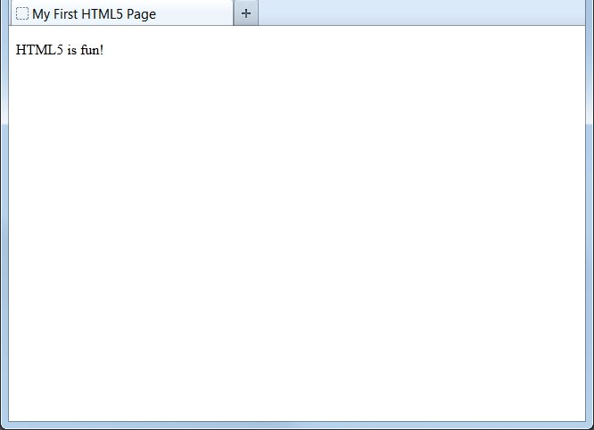
Viewing the HTML5 Web Page
Even though we used HTML5, the page looks exactly the same in a web browser as it would in XHTML. Without looking at the source code, web visitors will not know which version of HTML the page was created with.

Slide 137
Browser Support
http://html5test.com/

Slide 138
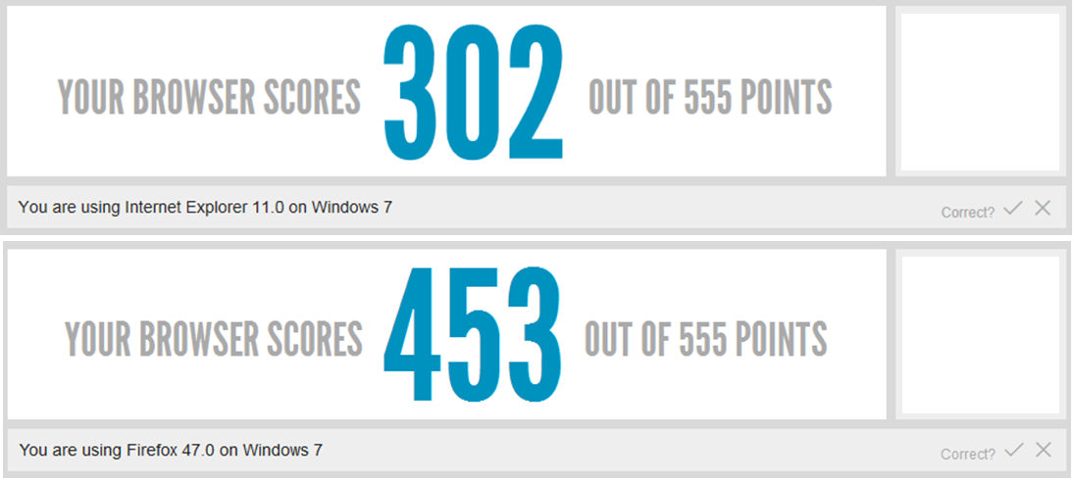


Browser Support

Slide 139
Web Application
Server Side Web Application
Asp.NET , ASP.NET MVC , ASP.NET Web API
Client Side Web Application
Angular, KO JS , React,

Slide 140
Pattern

Slide 141
ASP.NET
System.Web => asp.net
System.Web.MVC=>ASP.Net MVC
System.Web.http=> Web API

Slide 142
ASP.NET
Page Controller Pattern
Productivity is the KING
RAD for Web
Abstract Client Side Web Technologies
HTML, JS, CSS

Slide 143
Server Control
Web Server Control
Functionality (Rich Controls)
Uniformity between Web App and Windows App
Control State
View State
Event Binding
Browser Specific Output

Slide 144
UI App
Boundary
UI(App to Human)
Default.aspx
SI (App to Components/ App to App)
Controller
Controls Work Flow Logic(Bl,Dl,…)
Default.aspx.cs
Entity
Represents the data used in the system

Slide 145
Problem
1:1 View:Controller
Reusability=> redundancy

Slide 146
HTTP Pipeline
HTTP Request
Browser
IIS
ASP.NET Runtime Engine
HTTP Response
HTML
HTTP Application
HTTP Context
HTTP Module(s)
HTTP Module(s)
HTTP Module(s)
HTTP Handler

Slide 147
ASP.NET
ASP.NET MVC
System.Web
Page Controller Pattern
First is Page(UI) then Controller(BL/DL)
Page is View logic & Code behind is Controller Logic mapping (1View:1Controller)
Issues
Reusability(cannot use view without controller & vise-versa)
Testability(controller cannot be tested without View and vise-versa)
Parallel Project Execution
View & Controller must be programmed by one.
Design issues
Abstract Web Technologies
Generated code
not meant to be maintainable
Heavy (more infra code(Event wire-up, control state, session state….) )
Performance
Size of page is more
New Client Side Libraries
Jquery, JQueryUI, Bootstrap,KO…
System.Web.MVC
Front Controller Pattern
First is Controller then Result(UI, JSON, File…)
View:Controller *:*
Reusability
Testability – Controller without View & vise-versa
View & Controller can be designed by different developers
Design
Embraces Client-side web technologies
Code Generated is Pure HTML and Maintainable

Slide 148
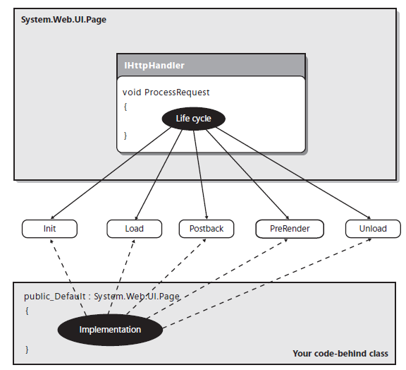
The Page Controller pattern in ASP.NET Web Forms

Slide 149
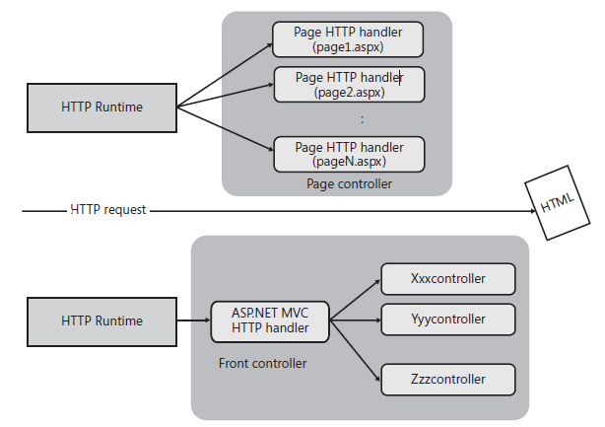
The Page Controller and Front Controller patterns
Notes:
The Front Controller pattern involves using a centralized component that handles all incoming requests and dispatches them to another component down the pipeline for actually servicing the request. How is this different from the Page Controller approach?
In the Page Controller pattern, there’s a different handler for each request, the specific handler for which is determined on a URL by URL basis. The Page Controller pattern suggests you build a hierarchy of pages to reuse some code across pages. Years of experience have proven that, in Web applications, pages in a hierarchy often grow over time with code that is not common to all pages in the hierarchy.
In the Front Controller approach, all incoming requests are channeled through a single component. In ASP.NET MVC, this component is the MVC HTTP handler. This common class contains the logic that parses the URL and decides which controller is due to service the request and which view component is due to produce the resulting HTML. The controller is a plain class with public methods, and each method executes an action following the user gestures. Figure 1-8 illustrates the difference between the Front Controller and Page Controller approaches in an ASP.NET scenario.

Slide 150
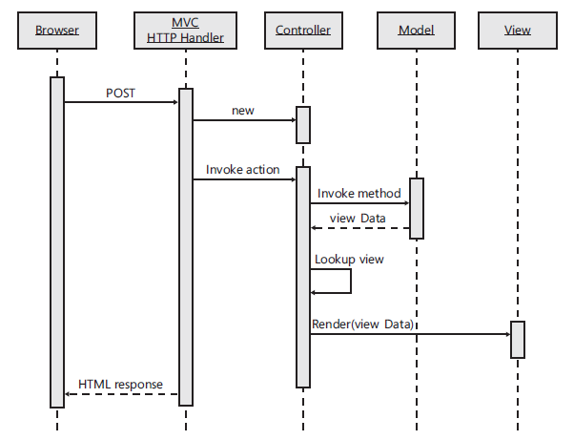
The Model2 pattern in ASP.NET MVC

Slide 151
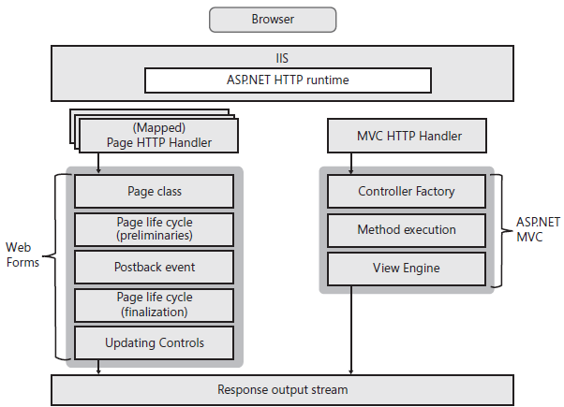
ASP.NET v/s ASP.NET MVC
The run-time stack of ASP.NET MVC and Web Forms

Slide 152
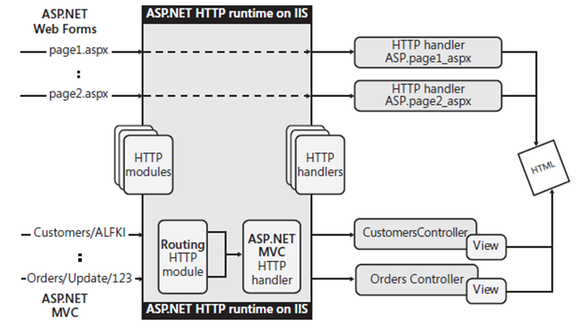
The runtime environments in Web Forms and ASP.NET MVC

Slide 153
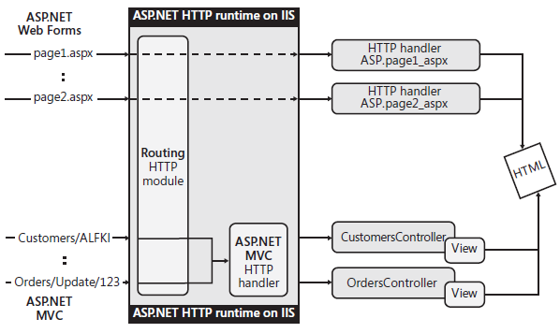
The role of the routing module in ASP.NET MVC

Slide 154
ASP.NET
ASP.NET MVC
Programming
File Extension
Explicit
.ASPX=Page
.ASCX=Control
.ASMX=Method
.ASAX=Application
….
ASP.NET View Engine
Explicit
Programming
File Extension
Implicit
.CSHTML=View
.CSHTML=Layout
.CSHTML=Partial View
VBHTML/CSHTML
….
Razor View Engine
Implicit

Slide 155
Middleware v/s HTTP modules and handlers
Modules, handlers, Global.asax.cs, Web.config (except for IIS configuration) and the application life cycle are gone
The roles of both modules and handlers have been taken over by middleware
Middleware are configured using code rather than in Web.config
Pipeline branching lets you send requests to specific middleware, based on not only the URL but also on request headers, query strings, etc.

Slide 156
HTTP Verb
Get
Post
Put
Delete
….

Slide 157
Server Control
Browser Specific Code
Jquery/ Jquery UI
Provide Rich controls
Calendar, Date Time, Grid
Jquery UI/ Bootstarp
Control State, Event Handling …
JQuery

Slide 158
Agenda
Controller
Create
Generate View
Model
Create
Generate Controller & Views
ADO.NET Entity Framework

Slide 159
Agenda 7 Apr 25
ASP.NET MVC
Controller
Basic
Action Result
Model Binder
Action Filters
Security
Exception Handling
View
Razor View Engine
Basic Syntax
Intro to Layout
Section
Nested Layout
HTML Helper
URL Helper
Validations
Client side
Inbuilt
Custom
Server Side
inbuilt
Custom
Contd…
Models
Validations Data-annotations
Configuring Entity Framework Data annotations
Entity Framework
Lazy Loading, Eager Loading, Dynamic loading
Transaction
Routing
Intro
Constraints
Config level
Application Level
Attribute based Routing
Controller/Method Level
State management
Application Level
Session Level
Between multiple Request and response
Between Controller and View
Between Controller to Controller

Slide 160
Model Binder
Browser=>”Form POST (EmpID, EmpName)”=> “Employee/Create”
Server=> Routing=> “{Controller}/{Action}/{id}” => Name of the Controller is EmployeeController => Action Method is “Create”
Create RouteData[“Controller”,”Employee”]
Basedon routedata => ControllerFactory will try finding class called “Employee” if found Create Instance of EmployeeController CALL ACTIONINVOKER forwarding EMPLOYEECONTROLLER Object with Method Name Called “CREATE” to be Invoked
Signature of Create method is “Create(Product prd)”
Forwards Argument Called Prd to be Resolved by MODEL BINDER
Model Binder =>
Created Object of Product class
Check for the Property name as Key in Form Collection part of Request Object if Found then TRY Converting the Data from the Request Object to Property of the Product Object for Eg. Lets say Property Name is “ProductName” and Request.Form[“ProductName”]=“Product 1”
obj.ProductName= Request.Form[“ProductName”]

Slide 161
Model Binder
Model Binder Server Side
Server Side Data Represended
Request object
QueryString
Collection
[“Email”,” Gane@123.com”]
[“FullName”,” Ganesh”]
…..
Routing
RouteData Collection
[“Controller”,” ModelBinderEg”]
[“Action”,” index”]
[“id”,” 123”]
HTTP Header
Request.Headers
Body
Raw
Custom
JSON
Form Data=>Request.Form
Browser
Data can be represented in
URL
QueryString
“http://localhost:59975/ModelBinderEg/index?Email=Gane@123.com&ConfirmPassword=a&FullName=Ganesh&Mobile=1234&Password=a&Score=5”
Routing
http://localhost:59975/ModelBinderEg/index/123
HTTP Header
Key & Value
Body
Raw
Custom
JSON
Form Data

Slide 162
Model Binder
Read Request Object for Data
Validate
ModelState is Collection
“FullName”, Errors collection =“Error object”

Slide 163
Validation
jQuery Intro
Validation
Custom Validation
Client-side Validation
Server-side Validation
Routing
State Management

Slide 164
jQuery
Is a JS Lib for Querying the DOM (Simplified Syntax)
API Programming Principle
Get and Act
Terminologies
The jQuery Function ($()) [GET] (90%) (has 4 overloads )
A jQueryObject
Methods for Common Operations [ACT]
A jQuery Function (5%)
Static function / helper function
Eg. $.AJAX()

Slide 165
FDS
Roles
Admin
Approve Vendor
Vendor
Registration
AcceptOrder
Customer
PlaceOrder
Delivery Agent
Delivery Request (Accept/Reject)
Pickup Order
Deliver Order
FDS
Security
SecUser

Slide 166
Login
UN & PWD
If Correct
Based on the Role from the user table must be redirected to specific Landing Page(Admin, Vendor, Customer…)
Each Landing Page Will have respective Nav Bar( for Eg. Admin – Vendor Approve, vendor – suspend/resume )
All User Common Functionalities
Login & Logout

Slide 167
Agenda
Introduction to ASP .NET Core
Angular
Intro to Web API
Software Development Methodology (Agile and Scrum)
Cloud Computing
AZURE
Services
Storage
TABLE
BLOB
QUEUE
Database
AZURE SQL Server
DevOps
CI/CD

Slide 168
MVC=> Model then View Later Controller
With VS
Model then generate Controller through controller Generate View
MCV
URL points to a Page physical
In MVC must point to Controller (Class(Logical))
Front Controller pattern , Controller first then view
Challenge / Problem => Module Called “Routing”

Slide 169
Controller MVC 5
Must Inherit from a class that implements Icontroller or Implement Icontroller
Must be Suffixed with “Controller”
All PUBLIC methods in the controller will be treated as Action Method by default if not marked otherwise using NonAction Attribute
Action Method Will Return ActionResult = > Base class for Various Specific Results

Slide 170
Routing
Workflow
Check if the URL is not Physical
Routing module
Matches the URL with the Routes Sequentially from the top to the Bottom
If pattern is matched then it considers that route to resolve the controller & action method
Routing Intro
Catch All Param
Constraint
Custom
Routing Config Levels
Application Level(General)
Controller or Action Method Level (Specific)

Slide 171
Route Constraints
Regular Expression Constraint
HTTP Constraint
Custom

Slide 172
Route Configuration Level
App_Start Level => Application level
Attribute based Routing; Controller / Action method Level

Slide 174
State management
Passing Data
Between Controller and View
ViewData – mvc 2.0
ViewBag = 3.0
Between Controller to Controller
TempData
Between Request Same User (Session)
Client Side (Performance, Security, reliability )
URL, Routing , Hidden Variable, Cookies
Server Side
Session State
Between Users
Application
Cache

Slide 175
Application
Business Data-Business Transaction Data(RDBMS)
Application Data
User Data – logging
Application Service Data

Slide 176
Threading
Main()=>A()=>B()=>C()
Sync
Exec
Data
Monitor
Lock Block

Slide 177
Agenda
Controller
Model Binders
View
Razor View Engine
Layout
Nested Layout
Section
Validation

Slide 178
Model Binder
Mapping incoming Request carrying Data to Argument/Parameter
Default
Custom

Slide 179
Model Binders
HTTP REQUEST
HEADER : Key:Value
Browser
URL (Query String, Route Data)
HTTP Request
BODY (various Format(MIME))
JSON,XML,FORM,Custom…
MODEL BINDER

Slide 180
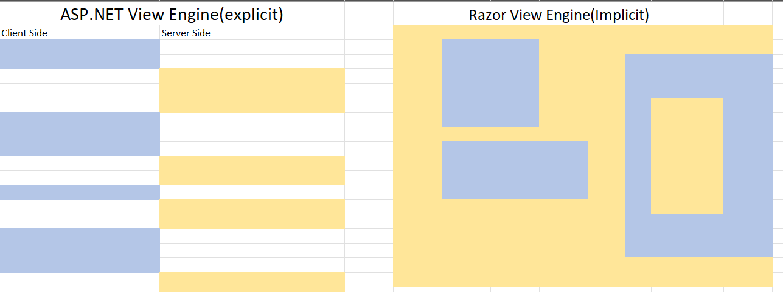
View Engine
Is a parser
Lists a bunch of syntax , and segregates it after

Slide 181
Razor Syntax
Block
@{}
Expression
Implicit
@
Explicit
@()
Escape
@: single Line Client Side
<text> </text> Multiline Line Client Side
@@ to Escape @
@[Programming Construct]
@For{}, @foreach{}, @if{}

Slide 182
Layout
UI
SDI
MDI
Layout

Slide 183
Specification
Functional
Physician
Patient
Supplier
Salesman
Non Functional
User

Slide 184
Agenda
Controller
Action Result
Action Selector
Action Filter
Inbuilt
User Defined
State Management
Client Side technique
Server Side technique
Exception Handling
Validation
Models
Validation Attributes
EF
Validation Extension
Controller
ModelState Object
View
HTML Helper Class
Intro to Web API vs WCF
REST/ SOAP
ASP.NET Core
EF Core
Code First
Intro to CSWA
Angular
Intro Cloud
MS AZURE
Resources
Storage
Microservice
DevOps

Slide 185
HTML Helper
Razor
HTML Helper
Validation
Client side
Inbuilt
Custom
Server Side
Inbuilt
Custom

Slide 186
Validation
Custom Validation on server
Create a class that must inherit from Any inbuilt validation(RequiredValidation…) of inherit from ValidationAttribute

Slide 188
Project Architecture
Server Side Web App
ASP.NET MVC
Database(Business Data)
SQL Server(RDBMS)

Slide 189
Project Workflow –
Functional
Guest Home Page =>Login=>based on Role => Landing Page
Admin=>CRUD(Doc,Pat,Sup,Che)=>Schedule
Physician=> View Schedule=>Adv & Pre(*), Drug Request, View P H
Patient=> Book appointment, View Appoint details, View P & A
Supplier=>View Purchase Order & Accept / Reject
Chemist => Place Purchase Order, View Drug Request , CRUD DRUG
Non Functional
Change User Name & Password

Slide 191
Exception Handling
CSharp
Try Catch
Destructor
Implicit
Explicit
Garbage Collection

Slide 192
Table Design
Master
Functional
Physician=>PhysicianID,Name,Address,Phone,Email,Specilization, Summary, USERID
Supplier => SupplierID, Name,Address,Phone,Email, USERID
Patient => Patient ID,DOB,Name,Address,Phone,Email,Gender, Summary, USERID
Chemist=> ChemistID, Name,Address,Phone,Email, Summary, USERID
Drug=> DrugId, Title, Description, Expiry, Dosage, USERID
Non Functional
User=>UserId,UserName,Password,Role

Slide 193
Table Design
Transaction
Functional
Appointment=>AppointmentID, PatientID, PhysicianID, AppointmentDateTime, Criticality, Reason, Note,ScheduleStatus
Schedule=> ScheduleId, AppointmentID, ScheduleDate, ScheduleStatus
PhysicianAdvice => PhysicianAdviceID, ScheduleId, Advise
PhysicianPrescrip => PhysicianPrescripID, PhysicianAdviceID, DrugID, Prescription
DrugRequest=> DrugRequestID, PhysicianID, DrugInfotext, RequestDate, RequestStatus
PurchaseOrder
PurchaseOrderHeader => POId,PODate,SupplierID
PurchaseProductLine => POID, DrugID, SlNo, Qty, Note

Slide 194

Admin
Schedule
Physician
Admin
CRUD(PPSC)

Slide 195
Physician
View Schedule
Physician
Advice & Prescription
Patient
Drug Request
Chemist

Slide 196
Patient
Create Appointment
Admin
View Schedule
Patient
View Advice & Prescription
Update Registered Details

Slide 197
Chemist
CRUD Drug
Create Purchase Order
Supplier
Chemist
View Drug Request

Slide 198
Supplier
View Purchase Order And Accept / Reject/..
Supplier

Slide 199
Agenda
Monday
Reflection & Attributes
Threading
System.IO
Serializer/De-serializer
Action Filters
Exception Handling
Asp.NET MVC
Try Catch
Destructor
Imp/Exp
GC
Tuesday
Intro to Web API
SOAP vs REST
WCF
Intro .NET Core
Wednesday
Angular
Thursday
Cloud Computing
MS Azure
Resources
DevOps
Friday
EnrLib

Slide 200
Flow of Events
Normal Flow
Alternative Flow
Regular
Odd Cases
Exceptional Case

Slide 201
Exception Handling
Runtime Error
Exception
App Ends
Data Loss
Resource Management
Boundary Class
Controller Class
Controls Workflow (Flow Logic)
Entity Class

Slide 202
Lesson 1: Introduction to Garbage Collection
The Object Life Cycle
Managed Resources in the .NET Framework
How Does the Garbage Collector Work?
Defining a Destructor
The GC Class
Demonstration: Implementing a Destructor
Notes:
Every object that you create has a life cycle, from creation to destruction. When an object is destroyed, its state must be cleaned, and any managed resources used must be reclaimed. In the .NET Framework, the garbage collector performs these tasks.
Explain that this lesson introduces garbage collection in the .NET Framework.

Slide 203
The Object Life Cycle
Block of memory allocated
1
Memory converted into an object (constructor)
2
Object used in application
3
Object tidied up (destructor)
4
Memory reclaimed
5
Notes:
Describe the object life cycle.
Explain that Steps 1 and 5 are handled by the runtime.
Explain briefly how a constructor and destructor fit into the object life cycle. (Students should already be familiar with constructors—destructors are explained later in this module.)
Explain that the runtime handles this process for managed objects only and that students must write their own code to allocate/deallocate memory for unmanaged objects.
Question: How can you control the creation phase for an object?
Answer: You add a constructor to the class.

Slide 204
Managed Resources in the .NET Framework
Value Types
Usually created on the stack
Destroyed automatically when they go out of scope
Never fragmented
Fast to allocate and deallocate
Reference Types
Created on the heap
Support multiple references to the same object
Can only be destroyed when the last reference disappears
Can cause memory fragmentation
Managed by the garbage collector
More expensive to manage
private void MyMethod(…)
{
MyStruct a = …;
DateTime z = …;
double y = …;
int x = …;
…
// x, y, z, and a disappear here
}
string s = …;
MyClass c = …;
private void MyMethod2(…)
{
string t = s;
MyClass d = c;
…
// References t and d disappear here
// Objects s and c remain on the heap
}
Notes:
Describe the stack and the heap.
Explain how value types can be added to the stack or the heap.
Explain that reference types are always added to the heap.
Describe how pointers are added to the stack for reference types and how this enables multiple pointers/references for the same object.
Explain how the stack and the heap take roughly the same amount of time to allocate memory, but the stack is much faster for deallocating memory.
Briefly mention the garbage collector and its role in reclaiming resources from objects added to the heap.
Question: Is the stack a first in, first out (FIFO), last in, first out (LIFO), first in, last out (FILO), or random access memory store?
Answer: The stack is a LIFO structure.
Additional Reading
For more information about automatic memory management, see the 3.9 Automatic memory management page at http://go.microsoft.com/fwlink/?LinkId=192943.

Slide 205

How Does the Garbage Collector Work?
Heap
Heap
Freachable
Stack
freachable
Stack
Location 2
Refs:
1, 4
Location 4
Refs:
5
Location 6
Refs:
Location 3
Refs:
1, 4
Location 6
Refs:
8
Location 9
Refs:
Location 1
Refs:
Location 3
Refs:
Finalizer
Location 5
Refs:
6
Finally:
Update Pointers
Start Finalization thread
James > 6
Location 2
Refs:
4
Location 2
Refs:
Location 5
Refs:
Finalizer
Location 8
Refs:
6
John > 4
5
Mark all objects as dead
Map which objects should stay alive
Add finalizable dead objects to the freachable queue
Remove dead objects and defragment heap
Update pointers
Start finalization thread
Location 1
Refs:
Location 1
Refs:
2, 3, 4
Location 1
Refs:
2, 3, 4
Location 4
Refs:
2
Location 4
Refs:
2
Location 7
Refs:
Location 7
Refs:
James > 6
John > 4
5
Notes:
This is an animated slide.
[Click 1]: All of the objects on the heap are considered dead (they are dark on the slide).
[Click 2]: The garbage collector starts at the bottom of the stack and marks the object referenced as alive (it lightens on the slide).
[Click 3]: The garbage collector follows the references in the objects it marks as alive and marks all of those objects as alive (The Refs section of Location 4 refers to Location 2).
[Click 4]: The garbage collector has no more references to follow (the Refs section for item 2 is blank) so it returns and starts at the next item in the stack (Location 6).
[Click 5]: Again the garbage collector follows the references in objects it has marked alive and marks them as alive (It follows the reference in the Refs section and proceeds to Location 8).
[Click 6]: The garbage collector does not return to objects already marked as alive to prevent circular references causing recursion (the Ref in Location 8 refers back to Location 6, and the garbage collector does not go back to Location 6).
[Click 7]: The garbage collector adds all dead objects that have a finalizer to the freachable queue (Location 5 is the only dead object that has a finalizer. Mention that this happens only once and objects that have been finalized are marked to prevent them being finalized twice).
[Click 8]: Objects added to the freachable queue are marked as alive (Location 5 lightens on the slide).
[Click 9]: Dead objects are removed (the dark items disappear).
[Click 10]: The garbage collector reorganizes remaining objects into a contiguous block.
[Click 11]: The garbage collector updates pointers and if necessary starts the finalization thread.
Question: What is the purpose of the freachable queue?
Answer: The freachable queue contains pointers to objects that are waiting for finalization.

Slide 206

Defining a Destructor
class Employee
{
...
~Employee
{
// Destructor logic.
}
}
Use a tilde (~) followed by the class name to define a destructor
Value types cannot define a destructor
class Employee
{
...
protected override void Finalize()
{
try
{
// Destructor logic.
}
finally
{
base.Finalize();
}
}
}
Destructors never take parameters
The compiler converts the destructor to an override of the Finalize method
Notes:
Describe the syntax for adding a destructor to a class.
Explain that Visual C# does not actually support destructors, and explain how the compiler converts a destructor to an override of the Finalize method.
Explain the structure of the Finalize method, including how it always ensures that the Finalize method of the base class is called.
Highlight that you cannot call the Finalize method in your own code.
Highlight that a destructor never takes any parameters.
Mention that destructors only apply to classes, not structs or enumerations.
Question: Can you add a destructor to a struct?
Answer: No. You can only add a destructor to a class.
Additional Reading
For more information about destructors, see the Destructors (C# Programming Guide) page at http://go.microsoft.com/fwlink/?LinkId=192944.

Slide 207
The GC Class
Name | Description
Collect | Forces garbage collection
WaitForPendingFinalizers | Suspends the current thread until all of the objects in the freachable queue have been finalized
SuppressFinalize | Prevents finalization of the object passed as the parameter
ReRegisterForFinalize | Requests finalization for an object that has either already been finalized or had finalization suppressed
AddMemoryPressure | Informs the runtime that you must allocate a large block of unmanaged memory
RemoveMemoryPressure | Informs the runtime that you have released a large block of unmanaged memory
Notes:
Describe the methods presented on the slide.
Mention that this is only a selection of the commonly used methods in the GC class—there are others.
Question: How can you inform the runtime that you need to allocate a large block of unmanaged memory?
Answer: You can use the AddMemoryPressure method of the GC class.
Additional Reading
For more information about the GC class, see the GC Members page at http://go.microsoft.com/fwlink/?LinkId=192945.

Slide 208
Demonstration: Implementing a Destructor
In this demonstration, you will see how to:
Add a destructor to the Employee class
Use the AddMemoryPressure method of the GC class to increase the pressure on the garbage collector
Use the WaitForPendingFinalizers method to halt the current thread until all objects currently in the freachable queue have finalized
Notes:
In this demonstration, you will see how to implement a destructor.
Demonstration Steps
Start the 10266A-GEN-DEV virtual machine, and then log on by using the following credentials:
User name: Student
Password: Pa$$w0rd
Start Microsoft Visual Studio® 2010:
Click Start, point to All Programs, click Microsoft Visual Studio 2010, and then click Microsoft Visual Studio 2010.
Open the Module 9, Demo1 starter solution:
On the File menu, point to Open, and then click Project/Solution.
Move to the E:\Demofiles\Mod9\Demo1\Starter\Destructor Demo folder, and then double-click Destructor Demo.sln.
In the Employee.cs file, add a destructor to the Employee class. The destructor should write the current salary to the SalaryDetails.txt file:
In Solution Explorer, double-click Employee.cs.
Add the code in the following code example to the file. ~Employee() { File.WriteAllText(“SalaryDetails.txt”, salary.ToString()); Console.WriteLine(“Employee finalized: {0}”, name); }
Walk the students through the other code in the Employee class. Highlight the code that reads the current salary from a text file.
Show the students the code in the Program.cs file. Highlight that each employee is given a pay rise and then the object reference is removed. Explain that this will make the object available for garbage collection and that the destructor will write the updated salary back to the file.
Run the application:
On the Debug menu, click Start Without Debugging.
Point out that all of the employees are paid the same amount; the pay rises do not reflect the update made to the text file by the destructor. Remind students that the garbage collector only runs when it needs to, and this program does not create enough objects or use enough memory to cause a collection.
In the Program.cs file, uncomment the call to the AddMemoryPressure method. Explain that this makes the garbage collector free as much memory as possible ready for a large allocation of unmanaged memory.
Run the application:
On the Debug menu, click Start Without Debugging.

Slide 209
Lesson 2: Managing Resources
Why Manage Resources in a Managed Environment?
What Is the Dispose Pattern?
Managing Resources in Your Applications
Demonstration: Using the Dispose Pattern
Notes:
The garbage collector automatically reclaims memory and resources for managed objects. However, if you use unmanaged resources in a class, you must take additional steps to ensure that they are released appropriately.
The dispose pattern is a design pattern that enables you to release unmanaged resources used by a class in a controlled and timely manner. Implementing the dispose pattern in your types will help to ensure that your applications perform well and do not retain unmanaged resources longer than necessary.

Slide 210

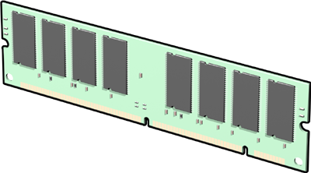

Why Manage Resources in a Managed Environment?
Unmanaged resources are not subject to garbage collection:
You must take responsibility for releasing them when an object is finalized
Failing to dispose of unmanaged objects properly can result in data loss
Example: Files may be locked, preventing other applications from using them
Example: Data cached in memory may be lost if resources are
not managed properly
Example: Connections to databases are often limited
Notes:
Explain how some valuable resources must be reclaimed as soon as possible and waiting for finalization may be too slow.
Remind students that they have no control over when objects are finalized or in what order.
Walk students through the three scenarios shown on the slide.
Question: What types of resources may need to be managed correctly?
Answer: Resources that are valuable, such as database connections, file operations, or objects that cache data in memory.

Slide 211


What Is the Dispose Pattern?
class LogFileWriter : …, IDisposable
{
private bool isDisposed = false;
~LogFileWriter()
{
Dispose(false);
}
public void Dispose()
{
Dispose(true);
GC.SuppressFinalize(this);
}
protected virtual void Dispose(bool isDisposing)
{
if (!isDisposed)
{
if (isDisposing)
{
// clean up managed resources;
}
// clean up unmanaged resources
isDisposed = false;
base.Dispose(isDisposing)
}
}
}
Implement the IDisposable interface
Track the object status
Add a destructor if you must ensure that the object is disposed of
Add a public Dispose method that disposes of resources and suppresses subsequent finalization
Add a virtual Dispose method that takes a boolean value indicating whether the object is currently disposing (or if false, finalizing)
Notes:
Walk students through the code example.
Describe the ObjectDisposedException exception (not mentioned on the slide), and explain that students must check for object disposal manually—the runtime does not track disposal.
Explain that adding a destructor is optional and not essential to implementing the dispose pattern.
Explain that students should call the SuppressFinalize method in the Dispose method to prevent finalization of a disposed object.
Question: What exception should you throw in your class if you attempt to use it after it has been disposed of?
Answer: You should throw an ObjectDisposedException exception.
Additional Reading
For more information about the Dispose method, see the Implementing a Dispose Method page at http://go.microsoft.com/fwlink/?LinkId=192946.

Slide 212
Managing Resources in Your Applications
Try/Finally:
Only use when using is not possible
Exception safe
DisposableObject disp = new DisposableObject();
try
{
// Use the object.
}
finally
{
disp.Dispose();
}
Using:
Use wherever possible
Exception safe
Only works with objects that implement the IDisposable interface
Should not be confused with the using statement for importing namespaces
using(DisposableObject disp = new DisposableObject()) {
// Use the object. }
// OR
DisposableObject disp2 = new DisposableObject();
using(disp2)
{
// Use the object.
}
Notes:
Describe how implementing the dispose pattern in a class is only half of the effort required to ensure that resources are managed effectively.
Explain that you must use the dispose pattern in code that uses disposable classes.
Explain that the runtime does not implement disposal for you.
Describe the try/finally and using syntaxes.
Explain that the using statement is the preferred approach to object disposal where it is possible.
Explain the importance of exception-safe disposal.
Question: If you do not dispose of an object when you have finished with it, will the runtime call the Dispose method automatically?
Answer: No. The runtime will not call the Dispose method; you must always add the code to call the Dispose method yourself.

Slide 213
Demonstration: Using the Dispose Pattern
In this demonstration, you will see how to:
Implement the IDisposable interface
Use a using statement to automatically dispose of an object
Manually dispose of an object
Notes:
In this demonstration, you will see how to use the dispose pattern.
Demonstration Steps
Start Visual Studio 2010:
Click Start, point to All Programs, click Microsoft Visual Studio 2010, and then click Microsoft Visual Studio 2010.
Open the Module 9, Demo1 starter solution:
On the File menu, point to Open, and then click Project/Solution.
Move to the E:\Demofiles\Mod9\Demo2\Starter\Dispose Demo folder, and then double-click Dispose Demo.sln.

Slide 214
UI

Slide 215
Agenda
28-Nov
View
Razor View Engine
Syntax
Layout
Nested
Section
Routing
Attribute based Routing
Controllers
Model Binders
Security
Assignment
Create Landing Page with Layouts & Menu for Each Role
29-Nov
Controller
Action Filters
Selectors
Exception Handling
State Management

Slide 216
Topic For Presentation
Reflection & Attributes
Delegates
Threading
Collections
Generic
LINQ to Objects
ADO.NET
Entity Framework –
ASP.NET Page Lifecycle
ASP.NET Controls
ASP.NET vs ASP.NET MVC
GC - Destructor
ASP.NET State Management
Routing
Model Binder
ASP.NET MVC Controller
Security
Exception Handling (CS & MVC)
Client Side Web App vs Server Side Web App
Cloud Computing
Dev Ops
.net framework vs .net core vs .NET
ASP.NET Web API
Azure Storage
AJAX -

Slide 217
Serialization
Why
Storage
Transport
Transform

Slide 218
.NET Core

Slide 219
Cloud Computing
Client
Server
Internet
Client
Server

Slide 220
Could Terminologies
Cloud
A metaphor for a global network, first used in reference to the telephone network and now commonly used to represent the Internet.
Cloud Computing
A computing capability that provides an abstraction between the computing resource and its underlying technical architecture (e.g., servers, storage, networks), enabling convenient, on-demand network access to a shared pool of configurable computing resources that can be rapidly provisioned and released with minimal management effort or service provider interaction.
This definition states that clouds have five essential characteristics:
on-demand self-service,
broad network access,
resource pooling,
rapid elasticity,
measured service.
Cloud Operating System
A computer operating system that is specially designed to run in a provider’s datacenter and be delivered to the user over the Internet or another network.
Windows Azure is an example of a cloud operating system or “cloud layer” that runs on Windows Server 2008.
The term is also sometimes used to refer to cloud-based client operating systems such as Google’s Chrome OS.

Slide 221



Cloud Services
“IaaS”
“PaaS”
“SaaS”
Infrastructure-as-a-Service
Platform-as-a-Service
Software-as-a-Service
host
build
consume
Notes:
Slide Objectives:
Explain the three established terms in the industry for cloud services
Speaking Points:
With this in mind, it’s important to understand how to talk about our Cloud Services offerings.
There is a lot of confusion in the industry when it comes to the cloud.
It’s important that you understand both what is happening in the industry and how we think about the cloud.
This is the most commonly used taxonomy for differentiating between types of cloud services.
The industry has defined three categories of services:
IaaS – a set of infrastructure level capabilities such as an operating system, network connectivity, etc. that are delivered as pay for use services and can be used to host applications.
PaaS – higher level sets of functionality that are delivered as consumable services for developers who are building applications. PaaS is about abstracting developers from the underlying infrastructure to enable applications to quickly be composed.
SaaS – applications that are delivered using a service delivery model where organizations can simply consume and use the application. Typically an organization would pay for the use of the application or the application could be monetized through ad revenue.
It is important to note that these 3 types of services may exist independently of one another or combined with one another.
SaaS offerings needn’t be developed upon PaaS offerings although solutions built on PaaS offerings are often delivered as SaaS.
PaaS offerings also needn’t expose IaaS and there’s more to PaaS than just running platforms on IaaS.

Slide 222
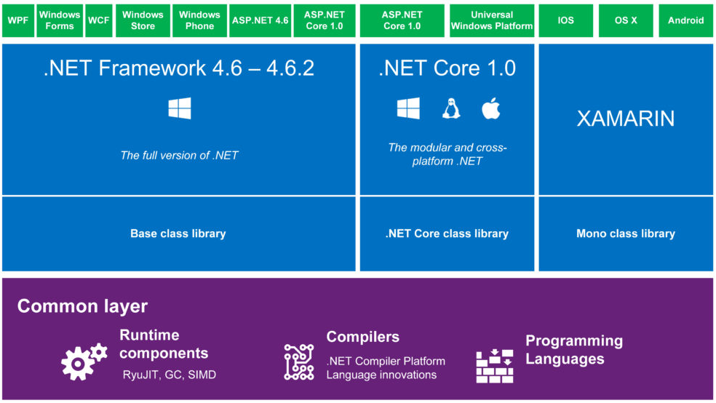
.NET Framework vs .NET Core

Slide 223
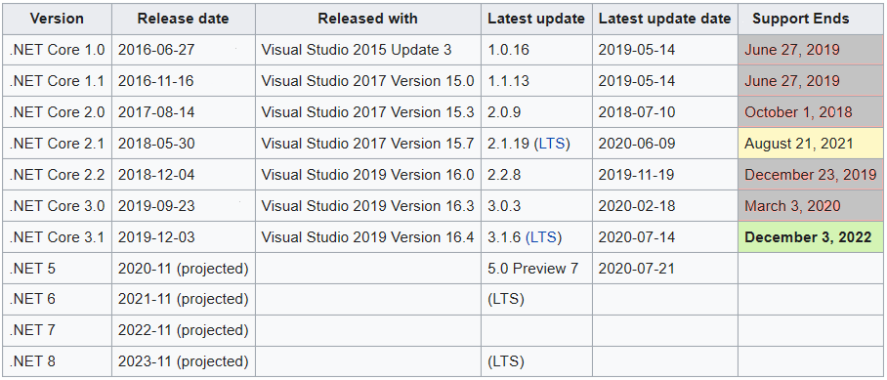
Version History
ASP.NET Version | VS
1.0 | 2002
1.1 | 2003
2.0 | 2005
3.5 | 2008
4.0 | 2010
4.5 | 2012
4.5.1 | 2013
4.6 | 2015

Slide 224
Agenda
SOLID
EntLib
Software Architecture
Agile – SCRUM
DevOps
Azure DevOps

Slide 225
Project Class Demo – Security Role Based
Menu
Common
Logout (Logged in Name)
About – CAS
Contact CAS
Trainer
Create Assignment
Create Exam/Test
View Schedule
Student
View Schedule
Take Exam
View Assignment
View Exam Result
Admin
CRUD (Trainer, Student)

Slide 226
Controllers

Slide 227
Agenda
Intro Controllers
Action Method
Action Result
Action Types (Get, Post)
Model Binders
Action Filters

Slide 228
Controllers
The ASP.NET MVC framework maps URLs to classes that are referred to as controllers.
Controllers process incoming requests, handle user input and interactions, and execute appropriate application logic.
A controller class typically calls a separate view component to generate the HTML markup for the request.

Slide 229
Controllers and Action Methods
The base class for all controllers is the ControllerBase class, which provides general MVC handling.
The Controller class inherits from ControllerBase and is the default implement of a controller.
The Controller class is responsible for the following processing stages:
Locating the appropriate action method to call and validating that it can be called.
Getting the values to use as the action method's arguments.
Handling all errors that might occur during the execution of the action method.
Providing the default WebFormViewEngine class for rendering ASP.NET page types (views).

Slide 230
Ctrl-Action Methods -Action Results
user interaction with ASP.NET MVC applications is organized around controllers and action methods.
The controller defines action methods.
Controllers can include as many action methods as needed.
Action methods typically have a one-to-one mapping with user interactions.
Examples of user interactions include entering a URL into the browser, clicking a link, and submitting a form. Each of these user interactions causes a request to be sent to the server.
In each case, the URL of the request includes information that the MVC framework uses to invoke an action method.

Slide 231
Action Methods- Action Result
Most action methods return an instance of a class that derives from ActionResult.
The ActionResult class is the base for all action results. However, there are different action result types, depending on the task that the action method is performing.
For example, the most common action is to call the View method. The View method returns an instance of the ViewResult class, which is derived from ActionResult.
You can create action methods that return an object of any type, such as a string, an integer, or a Boolean value.
These return types are wrapped in an appropriate ActionResult type before they are rendered to the response stream.

Slide 232
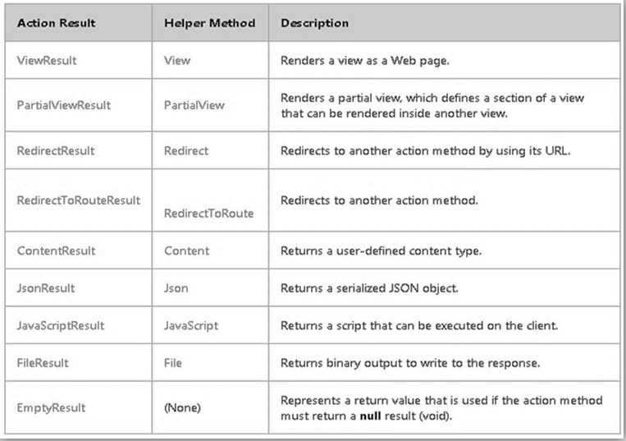
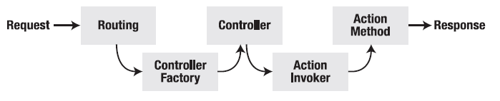
Ctrl-Action Methods -Action Results
Request Processing Pipeline
Inbuilt Action Results

Slide 233
Model Binders

Slide 234
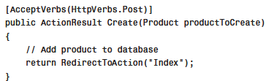
Model Binders
A model binder is responsible for mapping a browser request into an object.
Notice that the controller action in the clip accepts a Product parameter.
A model binder, in this case, the default model binder, is responsible for instantiating a new Product class for the parameter.
The default model binder also handles assigning the values of the HTML form fields to the properties of the new Product class.

Slide 235
Model Binders
The ASP.NET MVC framework ships with three model binders:
Default model binder
Form collection model binder
HTTP posted file base model binder

Slide 236
Using the Default Model Binder
The default model binder is smart enough to create a variety of different types of objects from a browser request including the following:
A primitive type such as a string, decimal, or DateTime.
A class such as a Product or Customer class.
An array such as a string or Product array.
A collections such as an IEnumerable<T>, ICollection<T>, IList<T>, Collection<T>, and List<T>.
A dictionary such as an IDictionary<TKey, TValue> and Dictionary<TKey, TValue>.

Slide 237
Default Model Binder
Demo
Binding to List
Binding to Complex Classes

Slide 238
Using the Bind Attribute
Bind attribute can be used to control how a model binder converts a request into an object.
The Bind attribute has the following properties:
Exclude—Enables you to exclude a comma-separated list of properties from binding
Include—Enables you to include a comma-separated list of properties in binding
Prefix—Enables you to associate a parameter with a particular form field prefix

Slide 239
Using the Form Collection Model Binder
As an alternative to using the default model binder to pass strongly typed parameters to a controller action, you can take advantage of the form collection model binder.
The form collection model binder represents an untyped collection of form fields.

Slide 240
Using the Form Collection Model Binder
The UpdateModel() method supports the following
parameters:
model—The object that is the target of the binding.
prefix—Only form fields with this prefix will be bound to the model.
includeProperties—An array of properties to include when binding.
excludeProperties—An array of properties to exclude when binding.
Notes:
valueProvider—The source of the information used during binding.
NOTE
Behind the scenes, the UpdateModel() method uses the set of model binders registered
for the application. For example, the UpdateModel() method uses the default
model binder and any custom model binders that you create.
The advantage of passing the form collection to the UpdateModel() method explicitly
is that it makes your code more testable. You can easily fake the form collection in
your tests.

Slide 241
Using the HTTP Posted File Base Model Binder
The third model binder included in the ASP.NET MVC framework is the HTTP posted file base model binder.
This model binder enables you to pass uploaded files to a controller action.

Slide 242
Creating a Custom Model Binder
The default model binder is powerful. However, it cannot handle every object. If you need to handle a type of object that is beyond the power of the default model binder, you need to create a custom model binder.
You create a custom model binder by implementing the IModelBinder interface. This interface has a single method named BindModel().
Notes:
.

Slide 243
Action Filters

Slide 244
Security
PL
BL
DL

Slide 245
When
Cross Cutting Concerns (Non Functional Requirement)
Functionality Common between Controllers

Slide 246
Understanding Action Filters
An action filter is a class that executes code before or after a controller action is invoked. You can use an action filter, for
example, to log each time a controller action is invoked.
You can do all manner of strange and interesting things in an action filter.
For example, you can use an action filter to modify the view data that a controller action returns.

Slide 247
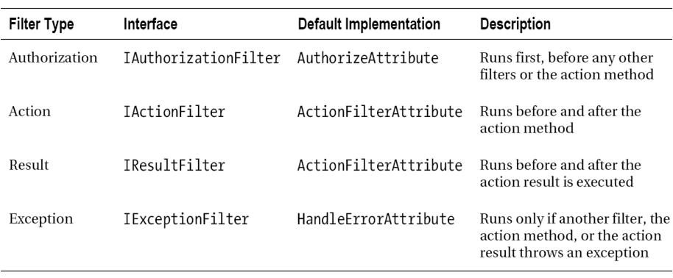
Action Filters- Types

Slide 248
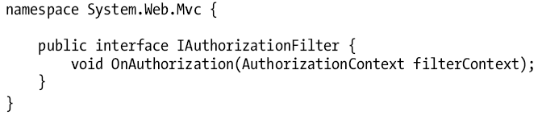
Authorization filters
They are run first—before the other kinds of filters and before the action method is invoked.
It enforce your authorization policy, ensuring that action methods can be invoked only by approved users.
It implement the IAuthorizationFilter interface,

Slide 249
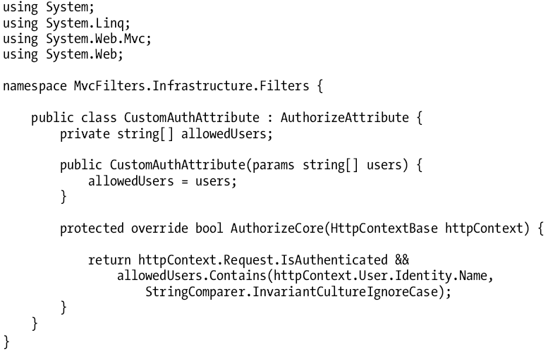
Custom authorization
Notes:
The simplest way to create an authorization filter is to subclass the AuthorizeAttribute class and
override the AuthorizeCore method. This ensures that we benefit from the features built in to
AuthorizeAttribute.

Slide 250
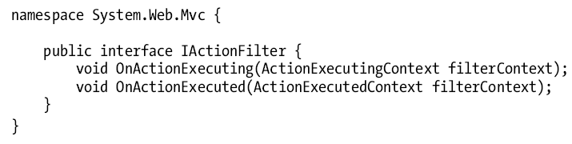
Action and result filters
Action and result filters are general-purpose filters that can be used for any purpose.
Both kinds follow a common pattern.
The built-in class for creating these types of filters, IActionFilter, implements both interfaces.

Slide 251
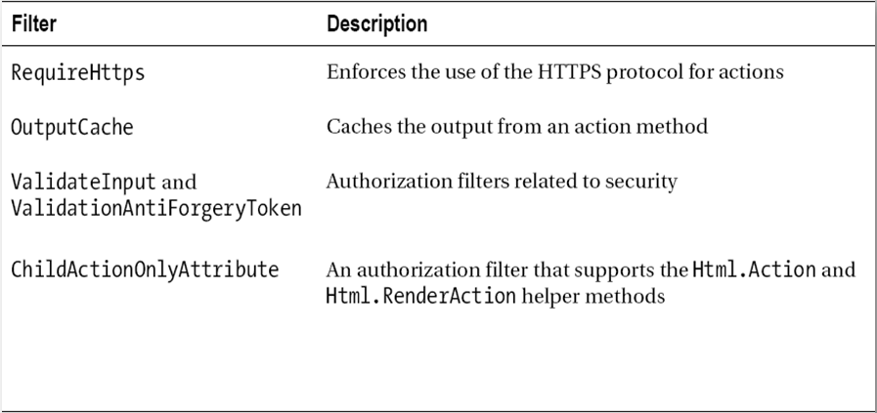
Built-In Filters

Slide 252
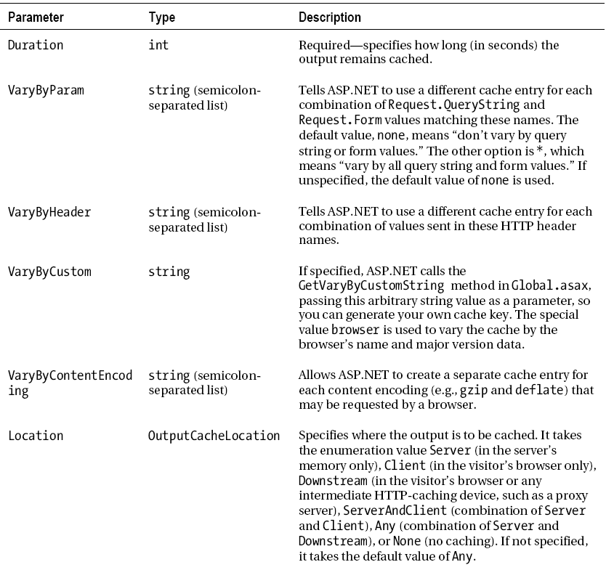
Output Cache

Slide 253
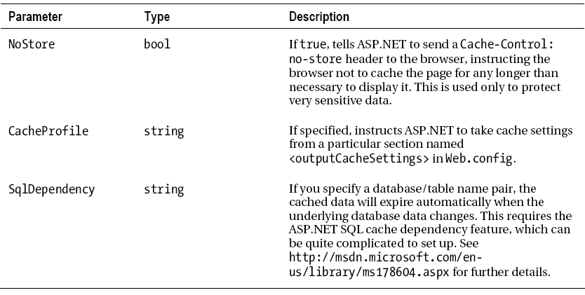
Output Cache

Slide 254
Action Filters
An action filter enables you to execute code in the following situations:
Immediately before a controller action is executed
Immediately after a controller action is executed
Immediately before an action result is executed
Immediately after an action result is executed
An action filter is an attribute that you apply to a controller action or entire controller.
Several features of the ASP.NET MVC framework are implemented with action filters.
For example, the OutputCache, HandleError, and Authorize attributes are all action filters.
Demo Log Action Filter
Notes:
NOTE
Technically, the Authorize and HandleError attributes are filter attributes instead of
action filter attributes. (Action filters derive from filters.) Because you want certain
types of filters to run before others, such as the Authorize filter, the ASP.NET MVC
framework distinguishes these two types of filters.
NOTE
As an alternative to using an action filter, you can handle the OnActionExecuting(),
OnActionExecuted(), OnResultExecuting(), or OnResultExecuted() methods on
the controller class. These events are raised before and after a controller action and
controller action result are executed.

Slide 256
ASP.NET MVC @ RAZOR

Slide 257
Passing Data in an ASP.NET MVC Application
Typed and Untyped Views
By Default view data dictionary is that it represents everything as untyped objects.
This means that you must cast items to a particular data type before you can use the items in a view.

Slide 258
Using Alternative View Engines
The default view engine for the ASP.NET MVC framework is the Web Forms view engine.
The Web Forms view engine uses ASP.NET pages as views.
The ASP.NET MVC framework was designed to support alternative view engines, and there are already several open source alternatives to the Web Forms view engine.

Slide 259
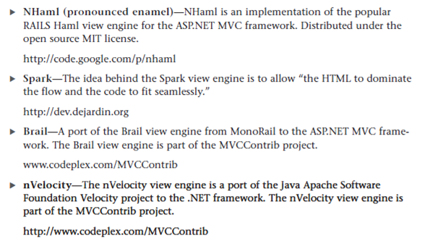
Using Alternative View Engines

Slide 260
ASP.NET MVC RAZOR Engine
What is Razor?
Alternate View Engine from Microsoft for ASP.NET MVC
Razor is a markup syntax for adding server-based code to web pages
Razor has the power of traditional ASP.NET markup, but is easier to learn, and easier to use
Razor is a server side markup syntax much like ASP and PHP
Razor supports C# and Visual Basic programming languages

Slide 261
Design Goals @ Razor
Compact, Expressive, and Fluid:
Razor minimizes the number of characters and keystrokes required in a file, and enables a fast, fluid coding workflow.
Unlike most template syntaxes, you do not need to interrupt your coding to explicitly denote server blocks within your HTML.
The parser is smart enough to infer this from your code. This enables a really compact and expressive syntax which is clean, fast and fun to type.
Easy to Learn:
Razor is easy to learn and enables you to quickly be productive with a minimum of concepts. You use all your existing language and HTML skills.
Is not a new language:
not a new imperative language , Instead Microsoft wanted it to enable developers to use their existing C#/VB (or other) language skills with Razor, and deliver a template mark-up syntax that enables an awesome HTML construction workflow with your language of choice.

Slide 262
Design Goals @ Razor
Works with any Text Editor:
Razor doesn’t require a specific tool and enables you to be productive in any plain old text editor (notepad works great).
Has great Intellisense:
While Razor has been designed to not require a specific tool or code editor, it will have awesome statement completion support within Visual Studio. Visual Studio 2010 and Visual Web Developer 2010 to have full editor Intellisense .
Unit Testable:
The new view engine implementation will support the ability to unit test views (without requiring a controller or web-server, and can be hosted in any unit test project – no special app-domain required).

Slide 263
Main Razor Syntax Rules for C#
Razor code blocks are enclosed in @{ ... }
Inline expressions (variables and functions) start with @
Code statements end with semicolon
Strings are enclosed with quotation marks
C# code is case sensitive
C# files have the extension .cshtml

Slide 264
Main Razor Syntax Rules for VB
Razor code blocks are enclosed in @Code ... End Code
Inline expressions (variables and functions) start with @
Variables are declared with the Dim keyword
Strings are enclosed with quotation marks
VB code is not case sensitive
VB files have the extension .vbhtml

Slide 265
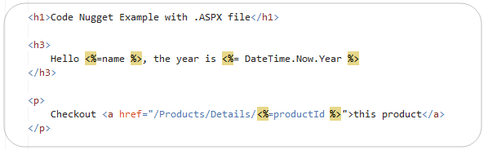
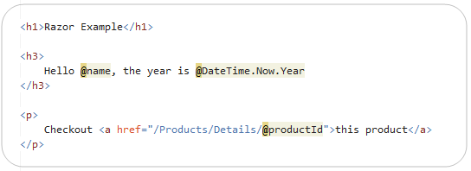
@RAZOR

Slide 266
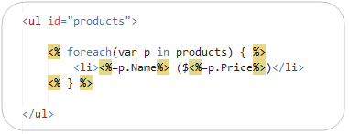
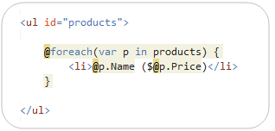
Loops and Nested HTML Sample

Slide 267
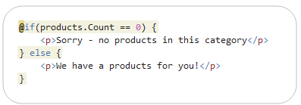
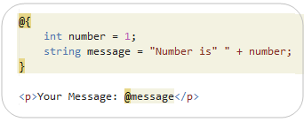
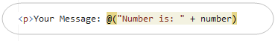
If-Blocks and Multi-line Statements
Multi-Token Statements
The @( ) syntax enables a code block to have multiple tokens. For example, we could re-write the above code to concatenate a string and the number together within a @( code ) block:

Slide 268
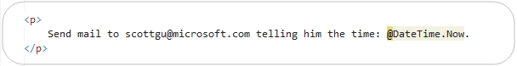
Integrating Content and Code
The Razor parser has a lot of language smarts built-into it – enabling you to rely on it to do the heavily lifting, as opposed to you having to explicitly do it yourself.
Razor’s language parser is clever enough in most cases to infer whether a @ character within a template is being used for code or static content.
demo@yahoo.com

Slide 269
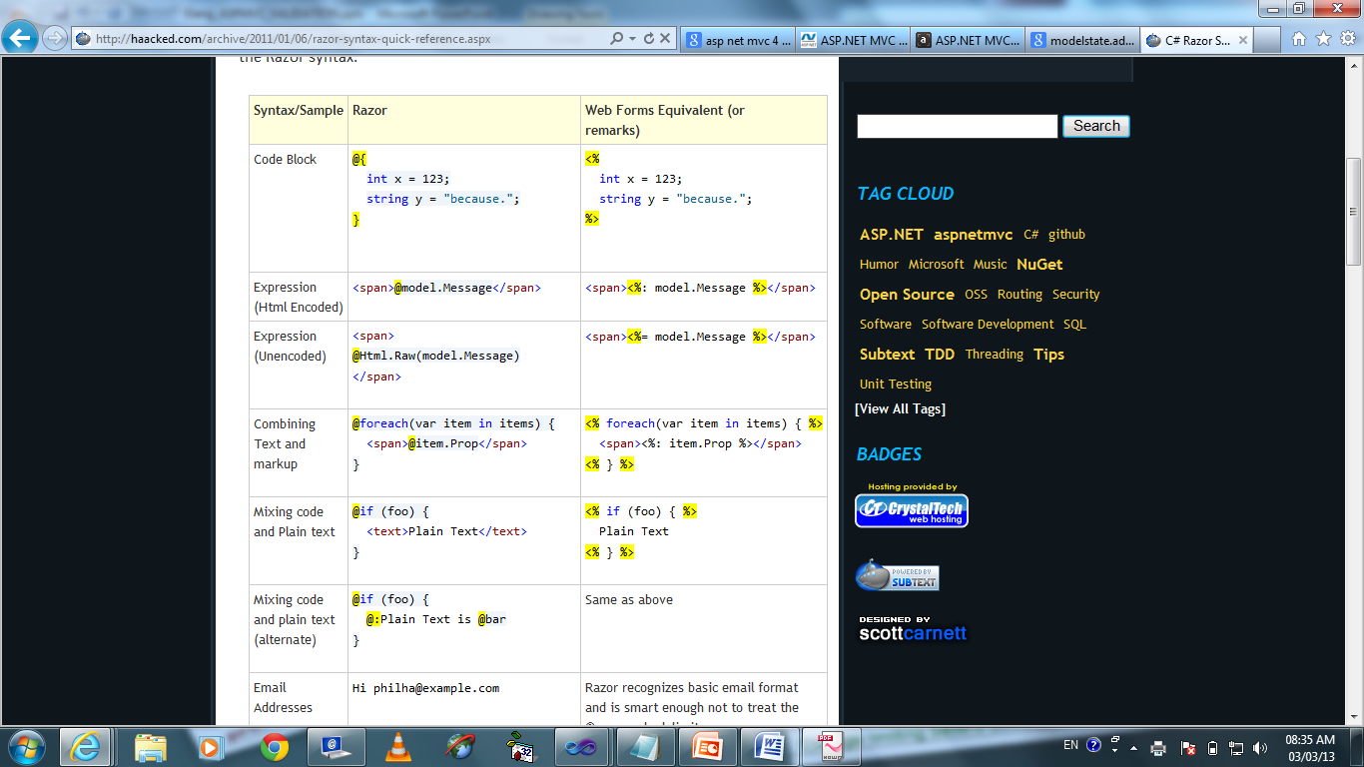
RAZOR v/s ASP. NET

Slide 270
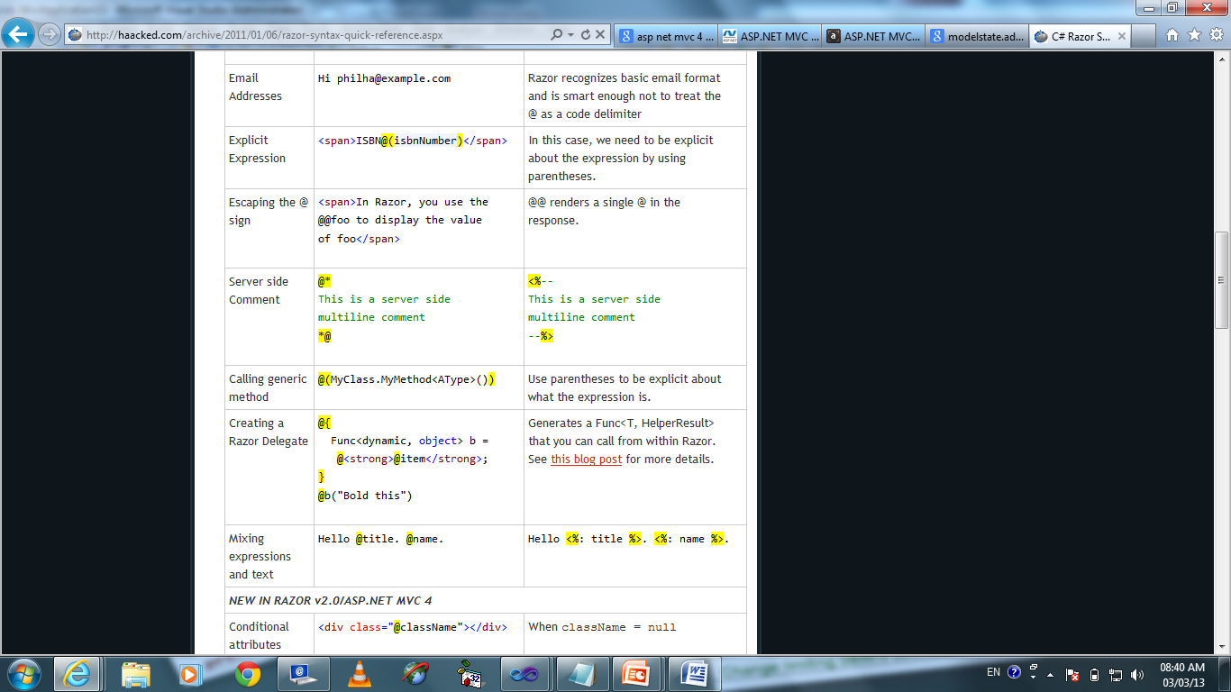
Demo@yahoo.com

Slide 271
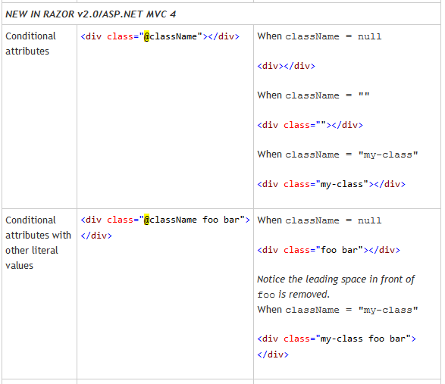

Slide 272
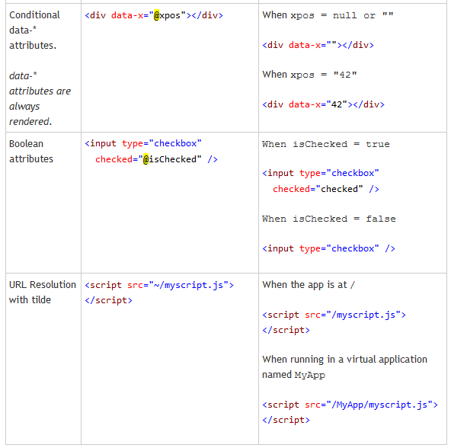

Slide 273
ViewData V/S ViewBag
While there isn’t a real technical advantage to choosing one format over there other.
One obvious one is that ViewBag only works when the key being accessed is a valid C# identifi er.
For example, if we place a value in ViewData[“Key With Spaces”], we can’t access that value using ViewBag.
Another key issue to be aware of is that dynamic values cannot be passed in as parameters to extension methods.
For example, this code
Error: @Html.TextBox(“name”, ViewBag.Name). The ways to workaround this are to either use ViewData[“Name”] or to cast the value to a specific type:(string)ViewBag.Name.

Slide 274
Helper Classes and Members for Rendering Views
When you create views, many tasks are repetitive or require special MVC framework knowledge.
To address these scenarios and to make it easier to render HTML, the MVC framework includes helper classes and members.
The design for helper classes is extensible so that you can add custom helper classes and members.
The MVC framework includes the following helpers:
Form helpers, which are for form elements such as radio buttons, list boxes, select buttons, text boxes, text areas, hidden content, and password fields.
URL helpers, which let you generate URLs for routing.
HTML helpers, which include functions to manage HTML strings, such as Encode, Decode, Attribute Encode, and RenderPartial.

Slide 275
HTML Helpers
Available HTML Helpers
ActionLink : Links to an action method.
BeginForm : Marks the start of a form and links to the action method that renders the form.
CheckBox :Renders a check box.
DropDownList :Renders a drop-down list.
Hidden :Embeds information in the form that is not rendered for the user to see.
ListBox :Renders a list box.
Password :Renders a text box for entering a password.
RadioButton :Renders a radio button.
TextArea :Renders a text area (multi-line text box).
TextBox :Renders a text box.

Slide 276
HTML Helpers
You can build an entire ASP.NET MVC application without using a single HTML helper; however, HTML helpers make your life as a developer easier.
By taking advantage of helpers, you can build your views with far less work.
In the ASP.NET MVC world, HTML helpers are the equivalent of ASP.NET Web Form controls.
Like a Web Form control, an HTML helper enables you to encapsulate the rendering of HTML.
However, unlike a Web Form control, HTML helpers are extremely lightweight.
For example, an HTML helper does not have an event model and does not use view state.

Slide 277
Using the BeginForm Helper
The BeginForm helper marks the start of an HTML form and renders as an HTML form element.
The BeginForm helper method has several overrides.
You can also use the BeginForm helper declaratively.
The difference between using BeginForm declaratively and using an HTML form tag is that BeginForm assigns default value for the action method and action attributes, which simplifies the markup.

Slide 278
Rendering Image Links
Rendering Image Links Unfortunately, you can’t use the Html.ActionLink() Helper to render an image link.
Because the Html.ActionLink() helper HTML encodes its link text automatically, you cannot pass an <img> tag to this method and expect the tag to render as an image.

Slide 279
Using Antiforgery Tokens
There is a particular type of JavaScript injection attack that is called a cross-site request forgery (CSRF) attack.
In a CSRF attack, a hacker takes advantage of the fact that you are logged in to one website to steal or modify your information at another website.
Notes:
To learn more about CSRF attacks, see the Wikipedia entry at http://en.wikipedia.org/
wiki/Csrf. The example discussed in this section is based on the example described in
the Wikipedia entry.
For example, imagine that you have an online bank account. The bank website identifies
and authenticates you with a cookie. Now, imagine that you visit a forums website. This
forums website enables users to post messages that contain images. An evil hacker has
posted an image to the forums that looks like this:
<img src=”http://www.BigBank.com/withdraw?amount=9999” />
Notice that the src attribute of this image tag points to a URL at the bank website.
When you view this message in your browser, $9,999 dollars is withdrawn from your bank
account. The hacker can withdraw money from your bank account because the bank
website uses a browser cookie to identify you. The hacker has hijacked your browser.
This helper creates a hidden input field that represents a cryptographically strong random
value. Each time you request the view, you get a different random value in a hidden field
that looks like this:
<input
name=”__RequestVerificationToken”
type=”hidden”
value=”6tbg3PWU9oAD3bhw6jZwxrYRyWPhKede87K/PFgaw
6MI3huvHgpjlCcPzDzrTkn8” />
The helper also creates a cookie that represents the random value. The value in the cookie
is compared against the value in the hidden form field to determine whether a CSRF
attack is being performed.
The Html.AntiForgeryToken() helper accepts the following optional parameters:
. salt—Enables you to add a cryptographic salt to the random value to increase the
security of the antiforgery token.
. domain—The domain associated with the antiforgery cookie. The cookie is sent only
when requests originate from this domain.
. path—The virtual path associated with the antiforgery cookie. The cookie is sent
only when requests originate from this path.
Generating the random value with the Html.AntiForgeryToken() helper is only half the
story. To prevent CSRF attacks, you also must add a special attribute to the controller
action that accepts the HTML form post. The Withdraw() controller action in Listing 6.6 is
decorated with a ValidateAntiForgeryToken attribute.

Slide 280

CSRF -Anatomy of an attack …
consider a user who wants to perform some online banking transactions.
This user first visits WoodgroveBank.com and logs in, at which point the response header will contain her authentication cookie:
Note : Because the authentication cookie is a session cookie, it will be automatically cleared by the browser when the browser process exits. However, until that time, the browser will automatically include the cookie with each request to WoodgroveBank.com.

Slide 281

CSRF -Anatomy of an attack …
The user now wants to transfer $1000 to another account, so fills out a form on the banking site, and the browser makes this request to the server:
the banking site has chosen to require an HTTP POST in order to initiate this operation. The server reads the authentication token from the request, looks up the current user’s account number, verifies that sufficient funds exist, and then initiates the transaction into the destination account.

Slide 282

CSRF -Anatomy of an attack …
User online banking complete, the user navigates away from the banking site and visits other locations on the web. One of those sites – fabrikam.com – includes the following markup on a page embedded within an <iframe>:

Slide 283

CSRF -Anatomy of an attack …
Which then causes the browser to make this request:
The attacker is exploiting the fact that the user might still have a valid authentication token for the target web site, and attacker is using a small snippet of Javascript to cause the browser to make an HTTP POST to the target site automatically. If the authentication token is still valid, the banking site will initiate a transfer of $250 into the account of the attacker’s choosing.

Slide 284


Antiforgery Tokens Implementation

Slide 285
HTML Helper
Normal
Typed

Slide 286
Custom HTML Helpers
Three Technique
Creating a static method
Writing an extension method
Using the @helper(razor only)

Slide 287
ASP.NET Mvc Core

Slide 288
ASP.NET Core v/s ASP.NET

Slide 289
.NET Framework

Slide 290


Slide 291
Version History
ASP.NET Version | VS
1.0 | 2002
1.1 | 2003
2.0 | 2005
3.5 | 2008
4.0 | 2010
4.5 | 2012
4.5.1 | 2013
4.6 | 2015

Slide 292
Decision table
Factor | ASP.NET Core | ASP.NET 4.x
Operating System | Windows, macOS, or Linux | Only Windows
Multiple versions per machine | Yes | No Only one
IDE Choice | Visual Studio, Visual Studio for Mac, or Visual Studio Code using C# or F# | Develop with Visual Studio using C#, VB, or F#
Web Server | Kestrel, HTTP.sys, reverse proxy server, such as IIS, Nginx, or Apache | IIS
Stable framework, Tested and proven for a decade | Yes more or less | Yes
Performance | Higher performance than ASP.NET 4.x | Good performance
Support for Dependency Injection | In built | Third Party

Slide 293
Using .NET Standard Libraries

Slide 294
.NET Standard Libraries
is the best way to add cross-platform support to a .NET library.
is a specification of .NET APIs that are available on all .NET implementations.
lets you produce libraries that are constrained to use APIs that are in a given version of .NET Standard, which means it's usable by all platforms that implement that version of the .NET Standard.

Slide 295

.NET Standard Libraries Stack

Slide 296
ASP.NET Core Middleware
Middleware is Method/Class that's assembled into an app pipeline to handle requests and responses. Each component:
Chooses whether to pass the request to the next component in the pipeline.
Can perform work before and after the next component in the pipeline is invoked.
Request delegates are used to build the request pipeline.
The request delegates handle each HTTP request.

Slide 297


ASP.NET Core Middleware
Request delegates are configured using extension methods
Use() - execute delegate and go to next pipeline step
Map() - conditionally execute delegate and return result
Run() - execute delegate and return result
An individual request delegate can be specified in-line as an anonymous method (called in-line middleware), or it can be defined in a reusable class.
These reusable classes and in-line anonymous methods are middleware, also called middleware components.
Each middleware component in the request pipeline is responsible for invoking the next component in the pipeline or short-circuiting the pipeline.

Slide 298

Request delegates
Chain multiple request delegates together with Use.
The next parameter represents the next delegate in the pipeline.
You can short-circuit the pipeline by not calling the next parameter.
The first Run delegate terminates the pipeline.

Slide 299
Order
The order that middleware components are added in the Startup.Configure() method defines the order in which the middleware components are invoked on requests and the reverse order for the response.
The order is critical for security, performance, and functionality.
Inbuilt common app middleware components
Exception/error handling
HTTP Strict Transport Security Protocol
HTTPS redirection
Static file server
Cookie policy enforcement
Authentication
Session
MVC

Slide 300

Asp.net core mvc - Request Pipeline

Slide 301
Middleware v/s HTTP modules and handlers
Modules, handlers, Global.asax.cs, Web.config (except for IIS configuration) and the application life cycle are gone
The roles of both modules and handlers have been taken over by middleware
Middleware are configured using code rather than in Web.config
Pipeline branching lets you send requests to specific middleware, based on not only the URL but also on request headers, query strings, etc.

Slide 302
Dependency injection in ASP.NET Core

Slide 303
Overview of dependency injection
A dependency is any object that another object requires.
Dependency injection addresses these problems through:
The use of an interface to abstract the dependency implementation.
Registration of the dependency in a service container. ASP.NET Core provides a built-in service container, IServiceProvider.
Services are registered in the app's Startup.ConfigureServices method.
Injection of the service into the constructor of the class where it's used.
The framework takes on the responsibility of creating an instance of the dependency and disposing of it when it's no longer needed.

Slide 304
Service lifetimes
Transient
lifetime services are created each time they are requested. This lifetime works best for lightweight, stateless services.
Scoped
lifetime services are created once per request within the scope. It is equivalent to Singleton in the current scope.
eg. in MVC it creates 1 instance per each http request but uses the same instance in the other calls within the same web request.
Singleton
which creates a single instance throughout the application. It creates the instance for the first time and reuses the same object in the all calls.

Slide 305
Service Injection
Controller Level
Action Method Level
View Level

Slide 306
AJAX
RIA
SPA

Slide 307
Model => Entity Class => Employee {empid:int, EmpName:string}
View => Display or Accept (txtEmpName , Create Button)
ViewModel => Data & Functionality

Slide 308



Virtual Machines
compared to
Docker Containers
App 1
App 2
App 3
+ Network isolation at container level
+ Resources constraints at container level
Bins/Libs
Bins/Libs
Bins/Libs
Guest OS
Guest OS
Guest OS
App/Svc 1
App/Svc 2
App/Svc 3
Bins/Libs
Bins/Libs
Bins/Libs
Hypervisor
Container Engine
Host Operating System
Operating System
Infrastructure
Infrastructure

Slide 309

Docker Engine for Linux and Windows

Slide 310

Microservices

Slide 311

Virtual Machine vs Container Architecture

Slide 312
Container Software
Docker
AWS Fargate
Google Kubernetes Engine
Amazon ECS
LXC
Notes:
Docker is a containerization software that performs operating-system-level-virtualization.
The developer of this software is Docker, Inc. The initial release of this software happened in the year 2013. It is written in ‘Go’ programming language. It’s a freemium software as a service and has Apache License 2.0 as the source code license.
Click here to view its repository.
Features
Integrated & Automated container Security Policy.
Runs trusted images only.
No Lock-in: Supports almost any type of application, OS, infrastructure, and orchestrator.
Unified and automated agile operations.
Portable containers across the cloud.
Automated governance.
Pros
Fits very well with CI/CD.
Saves storage space.
Plenty of docker images.
Saves hours in patching and downtime when compared to virtualization.
While working in a team, you need not worry about the different members having different versions of programming language, libraries, etc.
Open source.
A lot of plugins are available to enhance its features.
Cons
Quite tough to set up.
Takes a fair amount of time to learn this tool.
Creating persistent storage requires a lot of effort.
Does not have a GUI.
Does not have built-in support for Mac.
Tool Cost/Plan Details: It is a freemium software as a service. To use in a small team, you will get the starter package at $150. Additionally, the team and the production plan are also available. You need to contact the vendor for the pricing details of these plans.
AWS Fargate happens to be a compute engine for Amazon ECS and EKS* which lets you execute containers without any need to manage the servers or clusters.
Using AWS Fargate, you now don’t need to provision, configure, and scale cluster virtual machines to execute containers. This, in turn, eliminates the requirement to select server types, determine at what time to scale your clusters or optimize cluster packing.
Fargate allows you to concentrate on creating your applications rather than just managing the infrastructure that runs them.
Features
It manages the scaling and infrastructure requirements for containers on its own.
Allows launching thousands of containers in just seconds.
Supports heterogeneous clusters that are apt for rapid horizontal scaling.
Handles the bin packaging problem.
In-built support for the awsvpc network.
Pros
Building a cloud-native application is very easy with this tool.
Easy to scale up and scale down the production workloads dynamically.
Easy integration with the EC-2 instance.
Allows you to execute containers without worrying about managing clusters and servers.
Simple and easy to use User Interface.
Cons
Requires significant effort to learn and implement.
Quite costly when compared to the other container services.
As it’s a new product (introduced in 2017), its customer support is not that strong.
Limited container storage for the task.
Tool Cost/Plan Details: Its pricing is based on the virtual CPU and memory resource that is required for the task. The pricing also varies a bit from one region to another. For the US East, the charges are $0.0506 per vCPU per hour and $0.0127 per GB per hour.
Google Kubernetes Engine is a managed, production-ready infrastructure for implementing containerized applications. This tool was launched in the year 2015. It totally removes the need to install, handle and operate your own Kubernetes clusters.
Features
Hybrid networking via Google cloud VPN.
Identity and access management through Google accounts.
HIPAA and PCI DSS 3.1 compliant.
Managed open-source Kubernetes.
Docker image support.
Container Optimized OS.
GPU Support
Built-in dashboard.
Pros
Built-in load balancing.
Very intuitive GUI.
Effortless setup in Google cloud.
A cluster can be managed directly through the web interface.
Auto-scaling
Very easy to manage configurations.
Highly secured
Operates Seamlessly with 99.5% SLA.
Cons
Setting up a manual cluster is quite a time consuming and costly
Time-consuming in detecting errors and deploying the automated fix.
Logs are difficult to understand.
Need months to expertise in this tool.
Tool Cost/Plan Details: Pricing is on the basis of per instance for nodes in the cluster. Compute Engine resources are charged on a per-second basis with a 1-min minimum usage cost. You can get the price estimate by using the price calculator at google products price calculator.
The price will vary based on the number of instances, node type, storage space, etc.
Official Website: Google Kubernetes Engine
Amazon ECS (an acronym for Elastic Container Service) is an orchestration service that supports Docker containers and permits you to effortlessly execute and scale containerized applications on Amazon AWS.
This service is highly scalable and is high performing. It eradicates the requirement to install and manage your own container orchestration software and manages to cluster through virtual machines.
Features
Supports AWS Fartgate technology which handles the availability of containers.
Compatible with Windows containers through Amazon Machine Image(AMI).
Simplified local development through Amazon ECS CLI which is an open-source interface.
Tasks can be defined via declarative JSON template known as Task Definition.
Container Auto-recovery.
It provides 4 different types of network nodes for different use cases like Task networking/awsvpc, Bridge, Host, None, etc.
Integrated with Elastic Load Balancing.
Amazon Cloud Watch Logs and alarms for monitoring and access control.
Pros
Easy integration with other managed services present in Amazon cloud.
Provides a good foundation for Continuous Deployment pipeline.
Very flexible
Ability to define a custom scheduler.
Simplified interface
Powerful platform
Cons
Creating a load balancer service is quite challenging
Capacity problems while deploying the new version of the Docker image.
Tool Cost/Plan Details: There are two types of charge models for Amazon ECS i.e. Fartgate Launch Type Model and EC2 launch type model. With Fartgate, you will have to pay for the amount of virtual CPU and the memory resources used. Minimum charges of 1 minute apply here.
With EC2, there are no additional charges. You only have to pay for the AWS resources. No minimum charges are applied.
Official Website: Amazon ECS
LXC is the acronym for Linux Containers which is a type of OS-level virtualization method for executing numerous isolated Linux systems(containers) sitting on a control host employing a single Linux Kernel. This is an open source tool under the GNU LGPL License. It is available on the GitHub Repository.
This software is written in C, Python, Shell, and Lua.
Features
It has a Linux kernel cgroups functionality that permits the limitation and prioritization of resources with no requirement to set off virtual machines.
Namespace isolation functionality permits total isolation of the application’s view of the operating environment, comprising a network, UIDs, process trees and mounted file systems.
Combining the above two functionalities, LXC offers an isolated environment for applications.
Pros
Powerful API
Simple tools
Open-source
Of course, faster and cheaper than virtualization.
High-density deployment of containers.
Cons
Comparatively less secure than the other OS-level virtualization methods.
Only Linux containers can be executed under LXC. No windows, Mac or other OS.
Tool Cost/Plan Details: This tool is available at a free of cost.
Official Website: LXC

Slide 313
Docker
Docker is the leader in the containerization market.
Container images become containers at runtime and in the case of Docker containers - images become containers when they run on Docker Engine.
Available for both Linux and Windows-based applications, containerized software will always run the same, regardless of the infrastructure.
Containers isolate software from its environment and ensure that it works uniformly despite differences for instance between development and staging.

Slide 314

Virtual Machine vs Docker Container

Slide 315

Deployment

Slide 316
Version Control Systems (VCSs)
Help you track/manage/distribute revisions
Standard in modern development
Examples:
Revision Control System (RCS)
Concurrent Versions System (CVS)
Subversion (SVN)
Git
older
newer
Our focus

Slide 317


Why Git?
Git :most commonly used software for tracking changes in any set of files, usually used for coordinating work among programmers collaboratively developing source code during software development.
Git has many advantages over earlier systems such as CVS and Subversion
Subversion
Git

Slide 318

Object Model

Slide 319
Git History
Came out of Linux development community
Linus Torvalds, 2005
Initial goals:
Speed
Support for non-linear development (thousands of parallel branches)
Fully distributed
Able to handle large projects like Linux efficiently
Global Information Tracker (acronym name)

Slide 320
Development & Operations
As an IT consulting firm, while initiating a new project, we have two different kinds of teams.
First is the Development team, which is involved completely in developing and testing, including writing code and unit test cases.
The other team is the Operations team which is involved in operating and monitoring the product. •
Without DevOps, both teams (Development and Operations) work completely in an isolated manner.
If DevOps is not there then the team spends most of the time in building the code and deploying on multiple environments.
Each team waits for others to be done. This means, if development is going on then the testing team waits for the deployment of the code (Artifact) on the QA environment and in the same manner the operations team waits for the deployment on the Production environment.
So, due to this, a large amount of time gets wasted.
Building the code and deploying on specific environments in a manual fashion can increase the issues and resolving it will take a lot of time. Rather than doing it manually, we can make it automated using DevOps.

Slide 321
DevOps
is a combination of Development and Operations. It means Dev + Ops = DevOps.
It is a culture which automates systems and improves and accelerates delivery to the client in a repeated manner.
It’s basically a collaboration between the Development team and the Operations team for serving up a better quality application.
DevOps is practice collaboration between Development and Operations from the planning of a project to deployment on production.
It involves the complete SDLC life cycle as well as monitoring.

Slide 322

DevOps Lifecycle

Slide 323
DevOps Lifecycle
TEST
Testing is the heart of any development process. We write the Unit Test cases along with code. In DevOps, test cases auto execute and validate the build process.
RELEASE
In this stage, it collects the build artifact which can deploy further.
DEPLOY
Here, we start the deployment on the respective stages which are configured in the Release Pipeline.
Actually after testing and validating the build artifact, it auto starts the deployment on the respective environment using a continuous delivery process.
But before deploying it to the production environment, it asks for approval which can be done manually.
We can also automate the whole deployment process using continuous deployment. This is basically used when we have small changes which can be deployed on production as well without any approvals.
OPERATE & MONITOR
After successful deployment on the production environment, we have to operate the whole system and monitor the application. This monitoring is not only the performance but also the functionaliy

Slide 324


Slide 325

CI/CD
A continuous integration and continuous deployment (CI/CD) pipeline is a series of steps that must be performed in order to deliver a new version of software. CI/CD pipelines are a practice focused on improving software delivery throughout the software development life cycle via automation

Slide 326
Stages of a CI/CD pipeline
source stage
CI/CD pipeline is triggered by a code repository. Any change in the program triggers a notification to the CI/CD tool that runs an equivalent pipeline. Other common triggers include user-initiated workflows, automated schedules, and the results of other pipelines.
Build Stage
This is the second stage of the CI/CD Pipeline in which you merge the source code and its dependencies.
It is done mainly to build a runnable instance of software that you can potentially ship to the end-user.
Programs that are written in languages like C++, Java, C, or Go language should be compiled. On the other hand, JavaScript, Python, and Ruby programs can work without the build stage.
Failure to pass the build stage means there is a fundamental project misconfiguration, so it is better that you address such issue immediately.

Slide 327
Stages of a CI/CD pipeline
Test Stage
Test Stage includes the execution of automated tests to validate the correctness of code and the behaviour of the software. This stage prevents easily reproducible bugs from reaching the clients. It is the responsibility of developers to write automated tests.
Deploy Stage
This is the last stage where your product goes live. Once the build has successfully passed through all the required test scenarios, it is ready to deploy to live server.

Slide 328
Stages in Action
Source Code Control:
Host code on GitHub as a private repository. This will help you to integrate your application with major services and software.
Continuous integration:
Use continuous integration and delivery platform CircleCI and commit every code.
When the changes notify, this tool will pull the code available in GitHub and process to build and run the test.
Deploy code to User Acceptance Testing(UAT):
Configure CircleCI to deploy your code to AWS UAT server.
Deploy to production
You have to reuse continuous integration steps for deploying code to UAT.

Slide 329
CI/CD vs. DevOps Overview
CI/CD refers to a set of development practices that enable the rapid and reliable delivery of code changes
DevOps is a collection of ideas, practices, processes, and technologies that allow development and operations teams to work together to streamline product software building, testing, and release.
CI/CD is a DevOps tactic or a plan for attaining a that goal, which makes use of the right automated testing tools to implement agile development

Slide 330
What is a CI/CD pipeline?
A CI/CD pipeline automates the process of software delivery. It builds code, runs tests, and helps you to safely deploy a new version of the software.
CI/CD pipeline reduces manual errors, provides feedback to developers, and allows fast product iterations.
CI/CD pipeline introduces automation and continuous monitoring throughout the lifecycle of a software product.
It involves from the integration and testing phase to delivery and deployment; These connected practices are referred as CI/CD pipeline.

Slide 331

Continuous: Integration, Delivery, Deployment
Continuous integration
is a software development method where members of the team can integrate their work at least once a day.
In this method, every integration is checked by an automated build to search the error.
Continuous Delivery
Continuous delivery is a software engineering method in which a team develops software products in a short cycle.
It ensures that software can be easily released at any time.
Continuous deployment
is a software engineering process in which product functionalities are delivered using automatic deployment.
It helps testers to validate whether the codebase changes are correct, and it is stable or not.

Slide 332
Angular

Slide 334

Get Started with Angular
Building blocks of Angular

Slide 335

Model = Data
View = Presentation
DATA (MODEL)
View Model
Functionality/Behaviour

Slide 336


Angular UI as Component
Notes:
HeaderComponentResponsibilitiesAll aspects of authentication. Letting the user login/signup and logout.
InputsNone
OutputsLoginChanged — An output event that is fired when the users login state changes.
SidebarComponentResponsibilitiesPerforming searches
InputsNone
OutputsSearchTermChanged — An output event that is fired when a user performs a search, $event contains the search term.
ContentComponentResponsibilitiesShowing the search results.
InputsSearchTerm the search term that we want to filter the results by.
OutputsNone
Listing the inputs and outputs and what area this Component is responsible for helps to ensure the Components are architected correctly. The goal is for each Component to have a well defined boundary.

Slide 337
@Input @Output
Input- Data Binding
Component A
Component B
Output- Event Binding

Slide 338
Component
A component controls a patch of screen called a view.
At least one component in a Angular App
Components are building blocks of an Angular application.
A component is a combination of HTML template and a TypeScript (or a JavaScript) class.
HTML Template (Markup)
View Programing Logic
Data

Slide 339
Component based Architecture
Root Component
Main Content
Sub 1…
…
Navigation Bar
Search component
Composition

Slide 340

Component
Create a component
Create a class and decorate it with the @Component decorator.
Register in a module
Add an element in a html Markup
Notes:
ng g c <component Name>

Slide 341
@Component decorator
selector
is the name given to identify a component
used to refer to the component in another template or HTML code.
Template
is the markup for the given component. While the component is utilized, bindings with variables in the component class, styling and presentation logic are applied.
templateUrl
is the Url to an external file containing a template for the view. For better code organization, template could be moved to a separate file and the path could be specified as a value for templateUrl.
Styles
is used to specific styles for the given component. They are scoped to the component.
styleUrls
defines the CSS files containing the style for the component.
can specify one or more CSS files in an array.
From these CSS files, classes and other styles will be applied in the template for the component.

Slide 342
Template
Angular template is written in HTML
The <script>element is a notable exception; it is forbidden, eliminating the risk of script injection attacks.
Some legal HTML doesn't make much sense in a template. The <html>, <body>, and <base> elements have no useful role.

Slide 343

Template - data binding
Input –One-way (From Component)
Interpolation {{}}
Property Binding(Input)
Output –One-way (To Component)
Event Binding
Input & Output –Two Way
NgModel

Slide 344



Template – Data Binding
Binding types can be grouped into three categories distinguished by the direction of data flow:
from the source-to-view,
from view-to-source,
and in the two-way sequence: view-to-source-to-view:

Slide 345

Template- Data binding Statement Context
The statement context is typically the component instance.
refer to
properties of the template's own context
$event object,
a template input variable
(let emp),
a template reference variable
(#empForm)

Slide 346


Template- Data binding Binding targets
Binding targets
The target of a data binding is something in the DOM.
Depending on the binding type, the target can be an (element | component | directive) property, an (element | component | directive) event, or (rarely) an attribute name.

Slide 347

@Input @output C 2 C Communication

Slide 348
Directive
Built-in attribute directives
Attribute directives listen to and modify the behavior of other HTML elements, attributes, properties, and components.
NgClass
add and remove a set of CSS classes
NgStyle
add and remove a set of HTML styles
NgModel
two-way data binding to an HTML form element
FormsModule is required to use ngModel

Slide 349
Directive
Built-in structural directives
Structural directives are responsible for HTML layout.
They shape or reshape the DOM's structure, typically by adding, removing, and manipulating the host elements to which they are attached.
common structural directives
NgIf
conditionally add or remove an element from the DOM
NgSwitch
a set of directives that switch among alternative views
NgForOf
repeat a template for each item in a list

Slide 350

Pipes
Pipes are used to transform data, when we only need that data transformed in a template.
We use a pipe with the | syntax in the template, the | character is called the pipe character
A class with the @Pipe decorator defines a function that transforms input values to output values for display in a view.

Slide 351

Component lifecycle hooks
A component has a lifecycle managed by Angular.
Angular creates it, renders it, creates and renders its children, checks it when its data-bound properties change, and destroys it before removing it from the DOM.
Angular offers lifecycle hooks that provide visibility into these key life moments and the ability to act when they occur.
A directive has the same set of lifecycle hooks.

Slide 352
Component lifecycle hooks-Lifecycle sequence
Hook | Purpose and Timing
ngOnChanges() | Invoked every time there is a change in one of the input properties of the component.
ngOnInit() | Invoked when given component has been initialized. This hook is only called once after the first ngOnChanges
ngDoCheck() | Invoked when the change detector of the given component is invoked. It allows us to implement our own change detection algorithm for the given component. Note: ngDoCheck and ngOnChanges should not be implemented together on the same component.
ngOnDestroy() | This method will be invoked just before Angular destroys the component. Use this hook to unsubscribe observables and detach event handlers to avoid memory leaks.
Hooks for the components children These hooks are only called for components and not directives.
ngAfterContentInit() | Invoked after Angular performs any content projection into the components view
ngAfterContentChecked() | ResInvoked each time the content of the given component has been checked by the change detection mechanism of Angular.
ngAfterViewInit() | Invoked when the component’s view has been fully initialized.
ngAfterViewChecked() | Invoked each time the view of the given component has been checked by the change detection mechanism of Angular.
Notes:
Hook
Purpose and Timing
ngOnChanges()
Respond when Angular (re)sets data-bound input properties. The method receives a SimpleChanges object of current and previous property values.
Called before ngOnInit() and whenever one or more data-bound input properties change.
ngOnInit()
Initialize the directive/component after Angular first displays the data-bound properties and sets the directive/component's input properties.
Called once, after the first ngOnChanges().
ngDoCheck()
Detect and act upon changes that Angular can't or won't detect on its own.
Called during every change detection run, immediately after ngOnChanges() and ngOnInit().
ngAfterContentInit()
Respond after Angular projects external content into the component's view / the view that a directive is in.
Called once after the first ngDoCheck().
ngAfterContentChecked()
Respond after Angular checks the content projected into the directive/component.
Called after the ngAfterContentInit() and every subsequent ngDoCheck().
ngAfterViewInit()
Respond after Angular initializes the component's views and child views / the view that a directive is in.
Called once after the first ngAfterContentChecked().
ngAfterViewChecked()
Respond after Angular checks the component's views and child views / the view that a directive is in.
Called after the ngAfterViewInit and every subsequent ngAfterContentChecked().
ngOnDestroy()
Cleanup just before Angular destroys the directive/component. Unsubscribe Observables and detach event handlers to avoid memory leaks.
Called just before Angular destroys the directive/component.

Slide 353
Form
Approaches for creating form
Template-driven forms
Create Form Control and form Group based on directive
Reactive forms(Currently called) or model driven(Earlier called)
Create Form Control and form Group based on Code
Reactive Forms
More control over validation logic
Good for complex form
Unit test validation logic
Template-Driven Forms
Good for simple forms
Simple validation
Easier to create
Less code

Slide 354
Threading
Main()=>A()=>B()=C() (Call Stack)
Sync
Main()=> Thread of Control (Primary Thread)
Main()=>A()=>B()=>C()
=>….
Threading
Async
When/Why
Performance
Responsive

Slide 355
Thread Sync
Data
Execution

Slide 356
WCF- Windows Communication Foundation
One API for All Communication Requirement (unification & Simplification of all distributed Computing API into ONE)
Inter-process
DCOM
REMOTING(>.NET)
RPC
Intranet
DCOM
REMOTING
MSMQ
Internet
WEB Service
.NET 3.0

Slide 357
SOA
Discovery Agent-(UD,DI)
Basic Architecture
Web Service
BP-1.1
WS-*
WSDL
Publish
Find
Service Provider
Service Consumer
Communicate
SOAP

Slide 358
OOP Recap
Access Modifier
Inheritance
Sealed
Virtual
Abstract
Override
Overloading
Overriding

Slide 359
Project Database Table Design
PLMS
CAS

Slide 360
PLMS
Functional Requirement
Non-Functional Requirement
Admin
Add new LO, LI
Deactivate / Activate LO,LI
Loan Officer
Verifying the Application
Address verification
Income verification
Identity Verification
Loan Inspector
View & Approve /Reject Loan
Applicant/Customer
Register
Account Details
Apply for a Loan
Check Application status
Admin
Change Password
Loan Officer
Change Password
Loan Inspector
Change Password
Applicant/Customer
Sign up
Change Password

Slide 361
Non Func Req
User
UserID => PK- I
UserName – 20
Password- 10
Role
Email
Func Req
CustomerPrimary
CustomerID=> PKI
FullName vc(50)
DOB
MobileNo
Email
Gender
PCNo
AdNO
PhotoURL
ALLSupportDocURL
UserID => FK
CustomerAddress
AddressID PKI
CustomerID=> FK
Address
City
AddressType
CustomerBankAccount
BankAccountID PKI
CustomerID=> FK
AccountHolderName
AccountNo
AccountType
IFSC Code
Officer
OfficerID PKI
FullName
Address
City
UserID => FK
Inspector
InspectorID PKI
FullName
Note
UserID => FK

Slide 362
LoanApplication
LoanApplicationID
CustomerID
ApplicationDate
LoanRequestAmount
ROI
ReasonForLoan
LoanStatus
CompanyName
Income
TotalEMIPaidPerMonth
ApprovedAmount
ApprovedBYInspectorID
Note
CustomerVerificationStatus
VerificatiotStatusID
CustomerID
VerifiedByOfficerID
VerificationType-(Address,Identity…)
VerifiedDate
VerificationStatus
LoanEmiHeader
LoanEMIHeaderID
LoanAmount
FirstEMIDate
LastEMIDate
EMIAmount
IntRate
AmountDisbursed
DateOfCredit
LoanEMIDetail
LoanEMIHeaderID
EMINo
EMIActualDate
EMIPaidDate
EMIStatus
EMINote

Slide 363
CAS

Slide 364
Agenda
Angular
DevOps & Microservice=>cloud
MVC Misc
EH
Role Based Sec
Back button

Slide 365
Agenda
Security
Architecture current
EF Transaction
System.transaction
Transaction Scope
OOP
General FAQ

